Slide 1
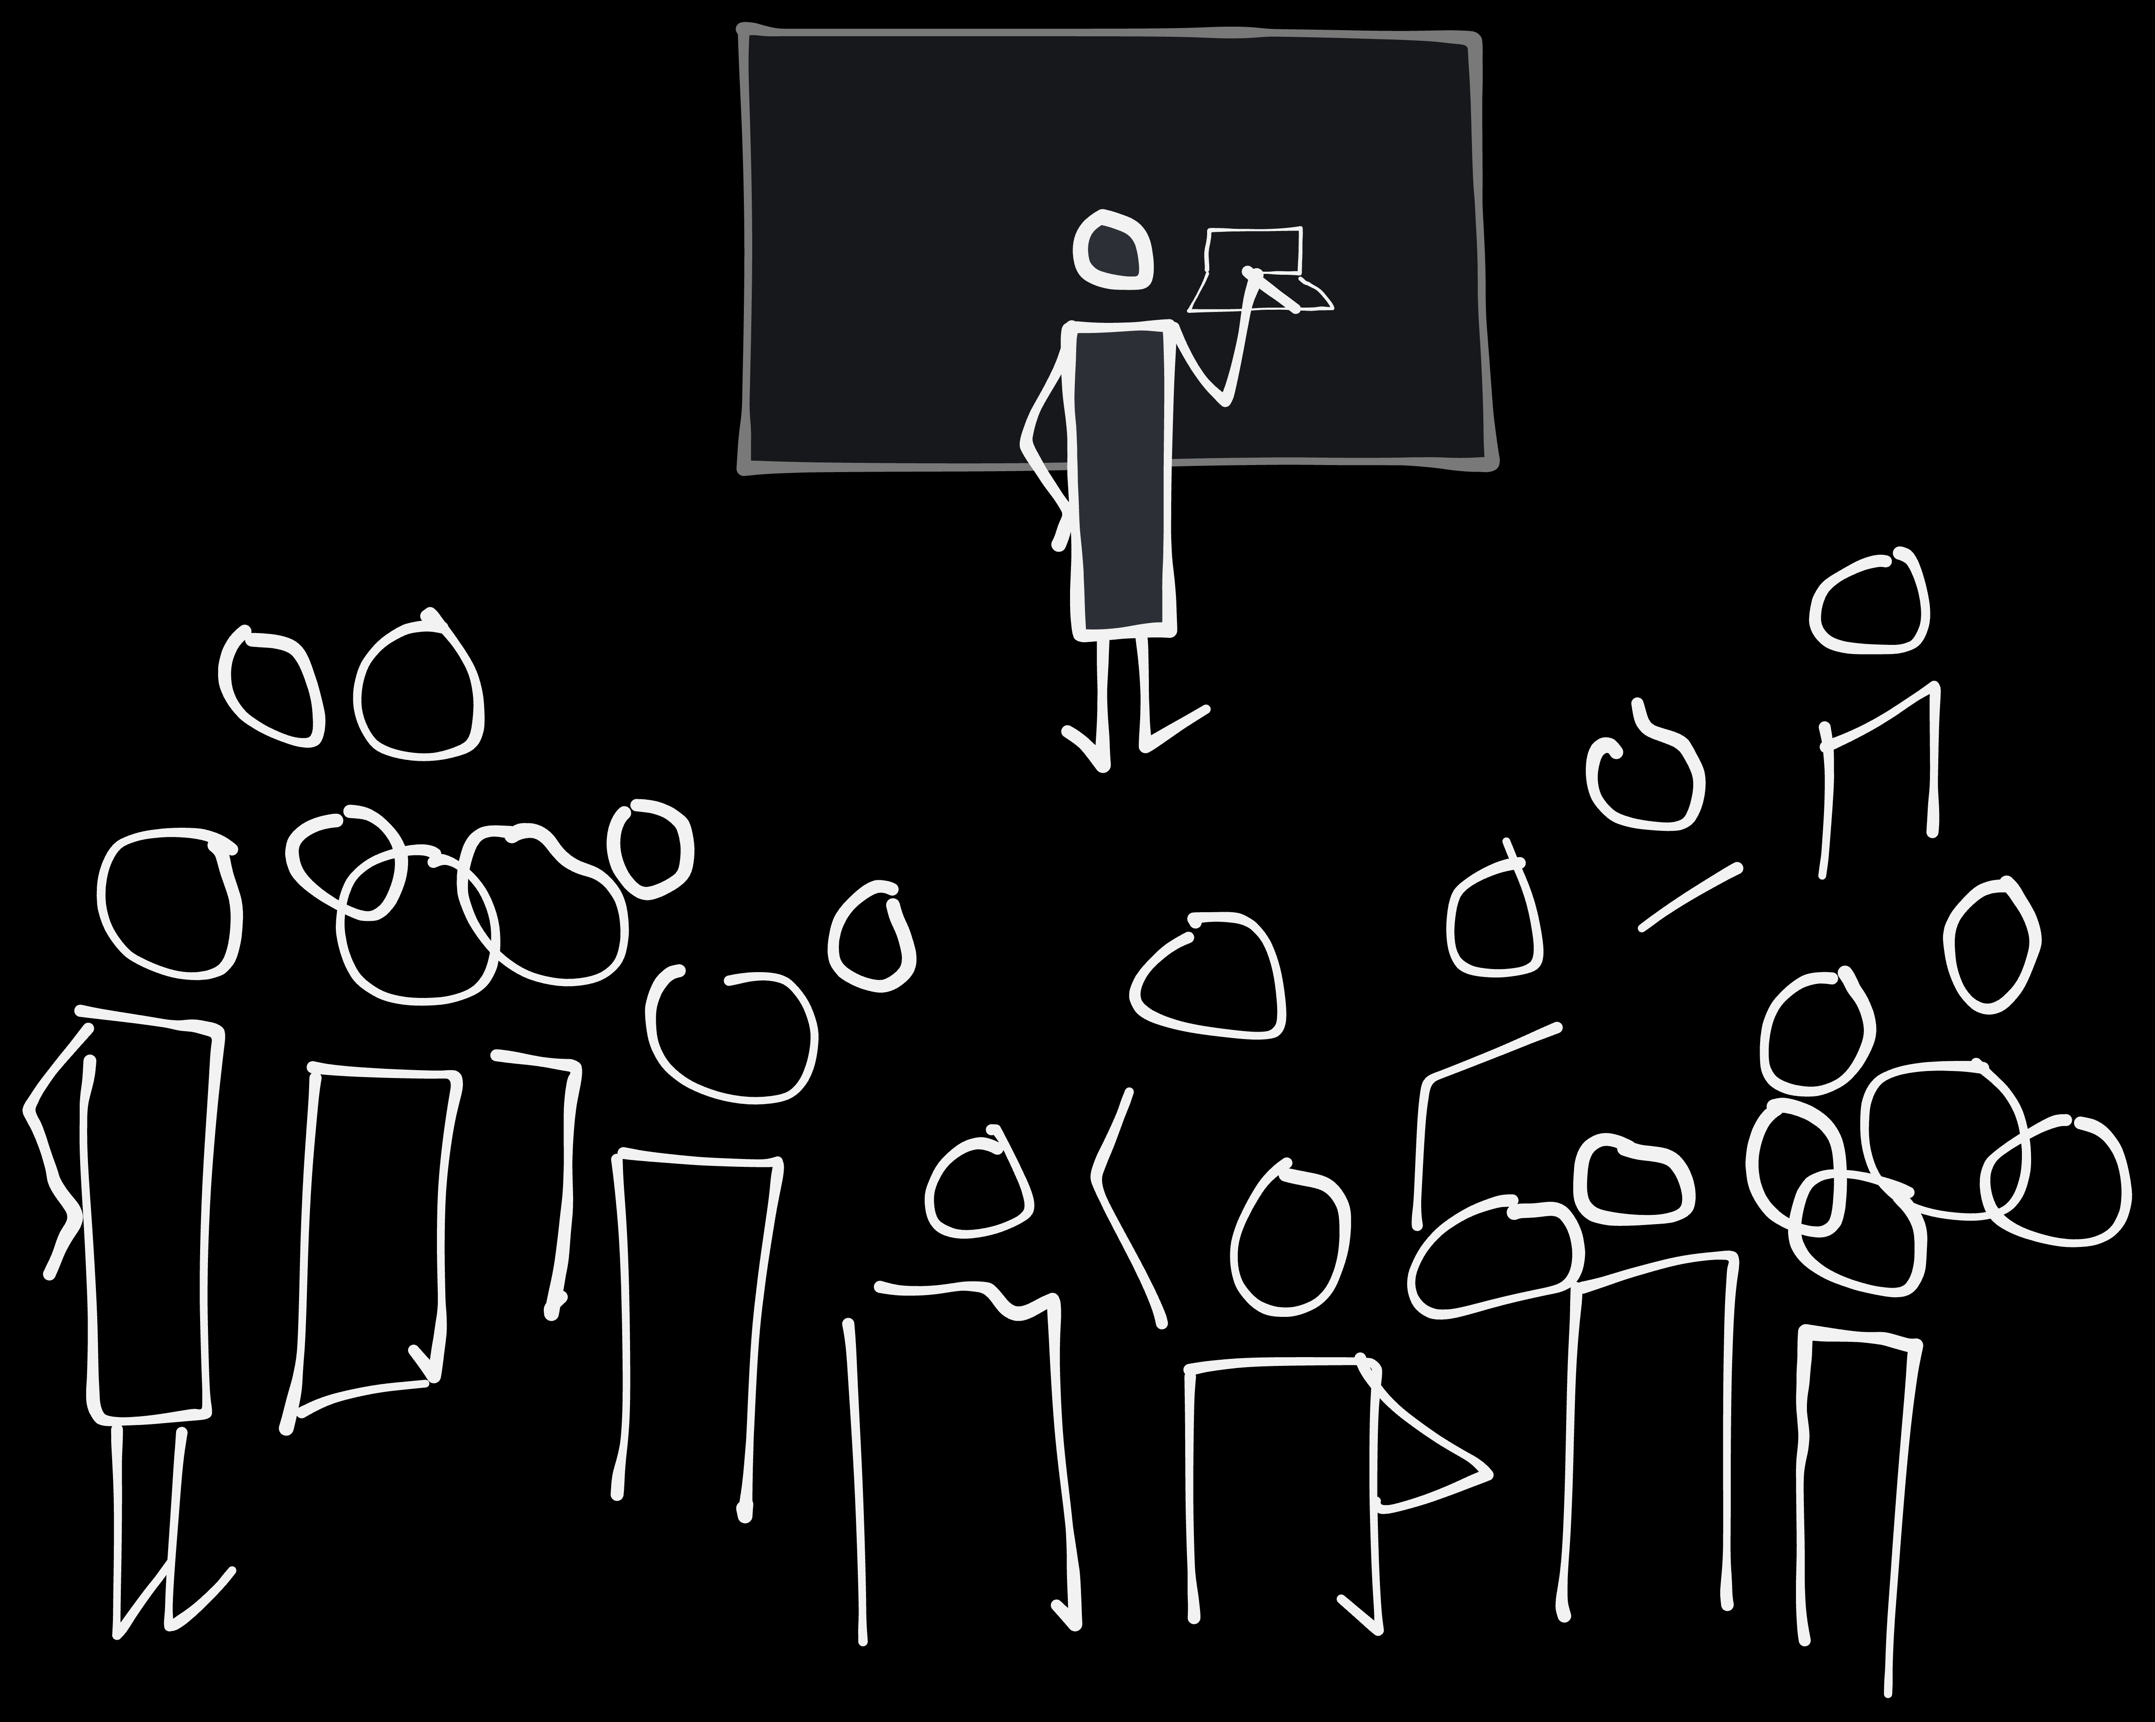
How to teach a million people to draw. Maybe...
By Espen Klem

Slide 2
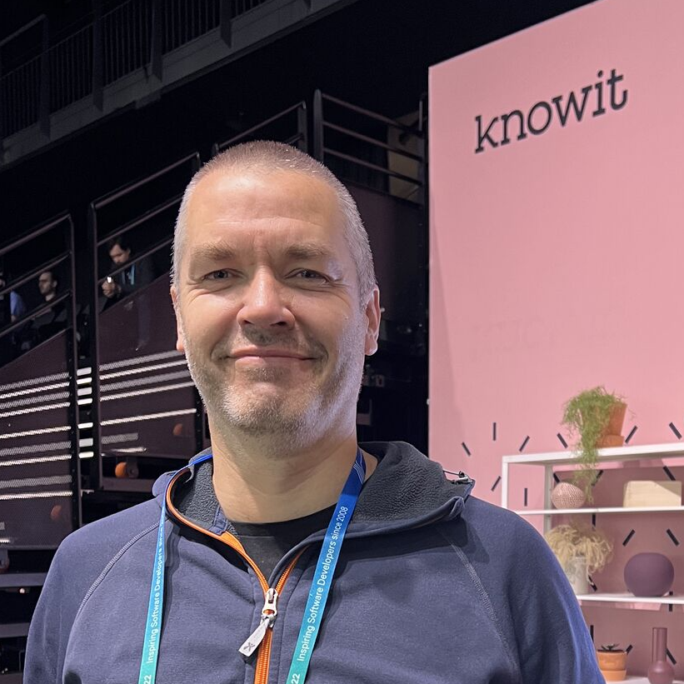
Who am I ?
28 years of web
Drawing to communicate
Espen klem
Notes:
28 years of web
Web design
Frontend code
Inteaction design
Drawing to communicate for the last 10 years – 5-6 years of trying to teach others.
Not drawing to create art or design. It’s a communication skill for all team members, developers, business people and designers.

Slide 3
The visual alphabet: What is it, and why

Slide 4


Notes:
It’s a small set of quite basic shapes, open and closed. There are many different visual alphabets as there are many different character based alphabets. This one is created by Dave Gray.
The intention of the library is to draw to communicate easier and less cognitive difficult.
The idea is that basing the things you draw on these shapes, you don’t have to think so much about how things actually look.
dot, line, angle, arch, spiral and loop
circle, lense, triangle, square/rectangle, pentagon/polygon and a cloud

Slide 5

Notes:
You may remember this from 20, 30 or 40 years ago. It’s basic stuff, but it communicates.

Slide 6

Notes:
And the business world isn’t that complicated to draw either.

Slide 7
Why draw at work
Notes:
This is not art, it’s communication. The intention here is that you draw to communicate. Everyone can master it. Then there are two things that matterrs:
That you draw fast enough
That what you draw precise enough
To draw precise enogh you have to have a clear understanding of what you want to communicate. My experience is that drawing helps for that to. Quite often I skip ideas I initially thought was good after trying to drawing them.

Slide 8

Why draw...
Notes:
Better thinking and sorting ideas

Slide 9
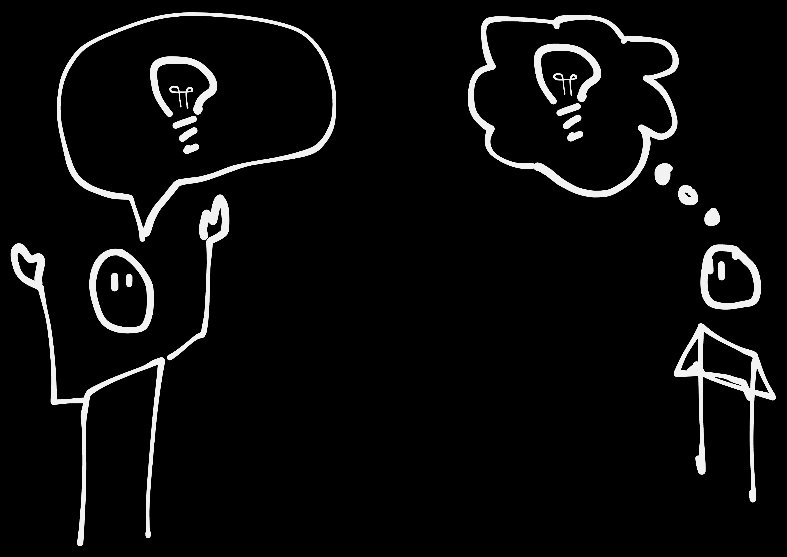
Why draw...
Notes:
Better communicating those ideas. And of course getting feedback or reactions

Slide 10
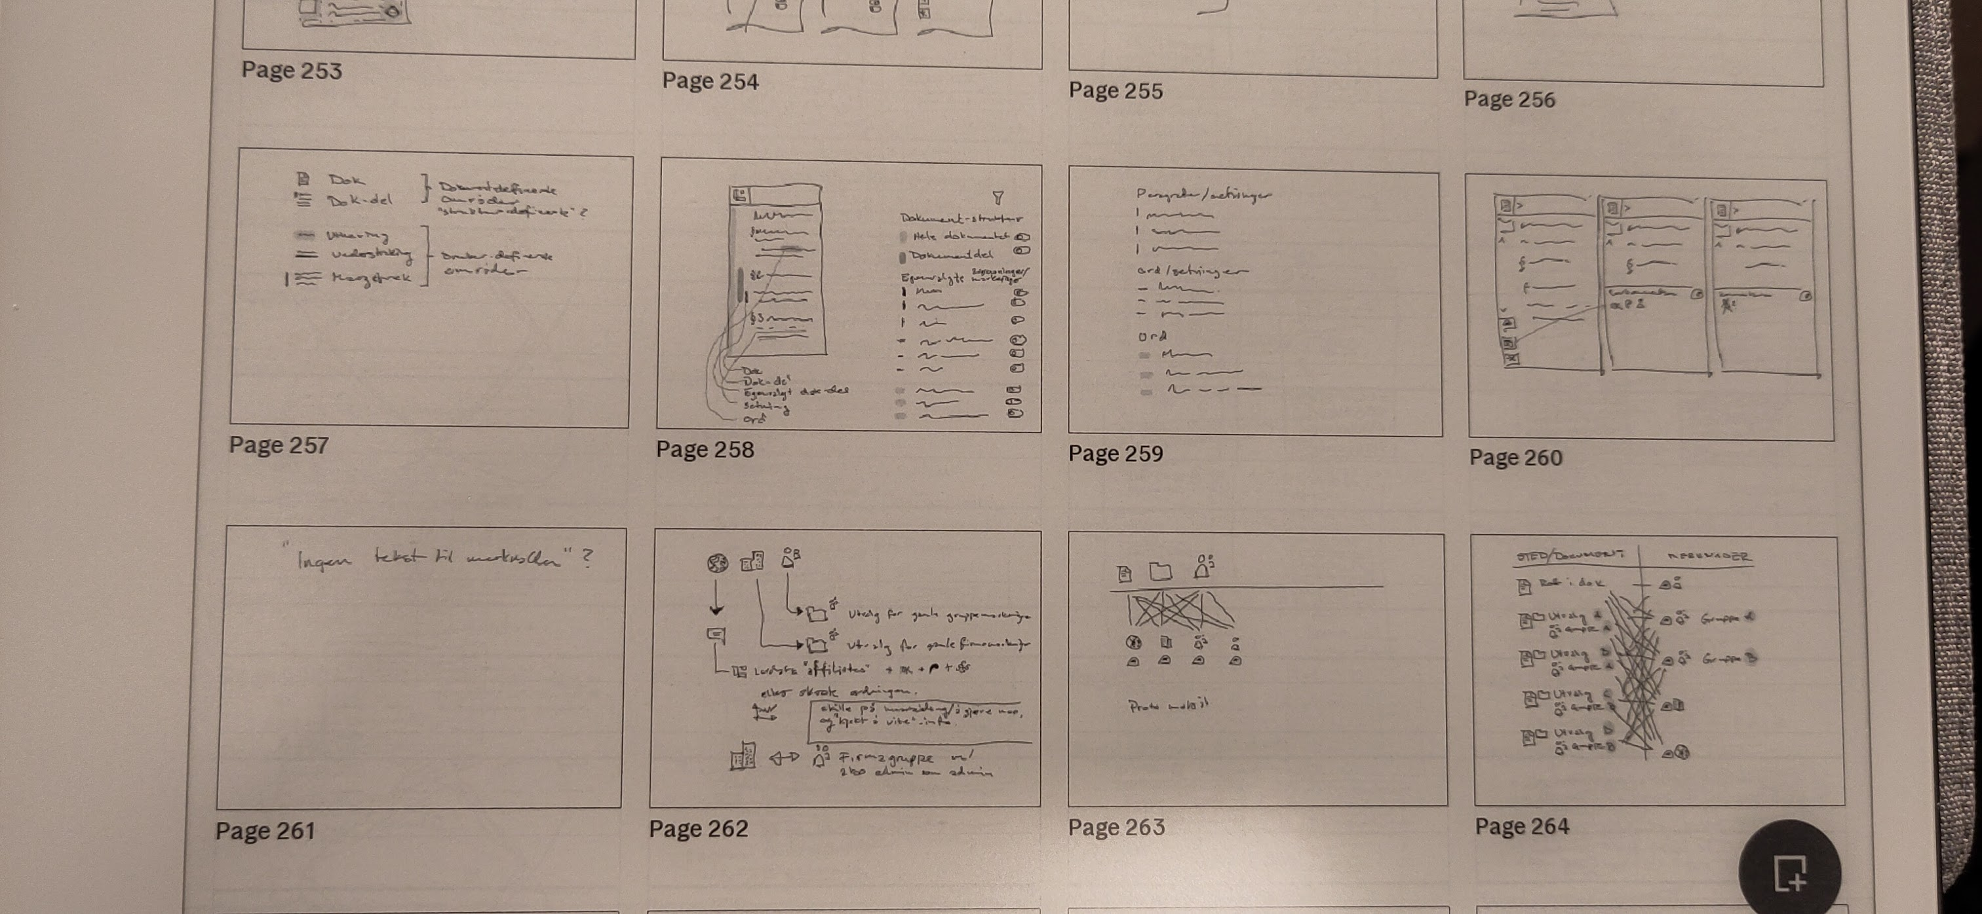
Why draw...
Notes:
Here are some examples from the customer I’m working for now. Most are just ideas on how to solve different interaction design issues, and to the bottom right I’m trying to convince the team that we are creating some issues for ourselves with how they wanted to solve a certain issue.
So figuring out for my self why it was a bad idea, and figuring out how to communicate it to them. Before I drew I had a hunch that what we were doing wasn’t so smart. After drawing I knew why. It was a discussion we’ve had over 2-3 years.

Slide 11
Figuring I could teach others
Notes:
I learned it from a colleague that got it from a talk on a conference. And she got it from

Slide 12
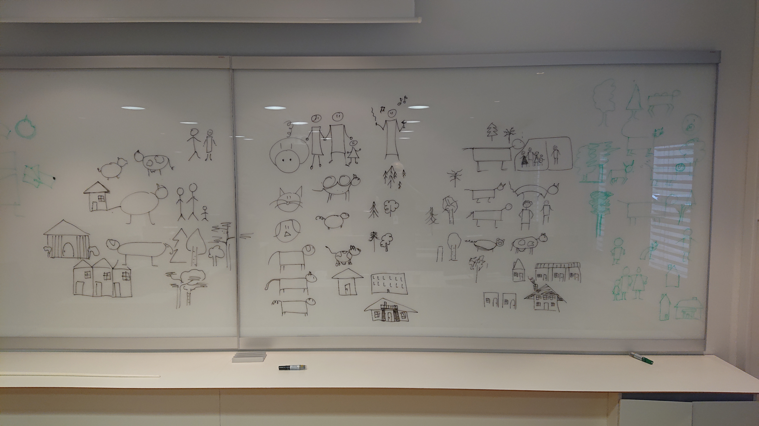

Slide 13
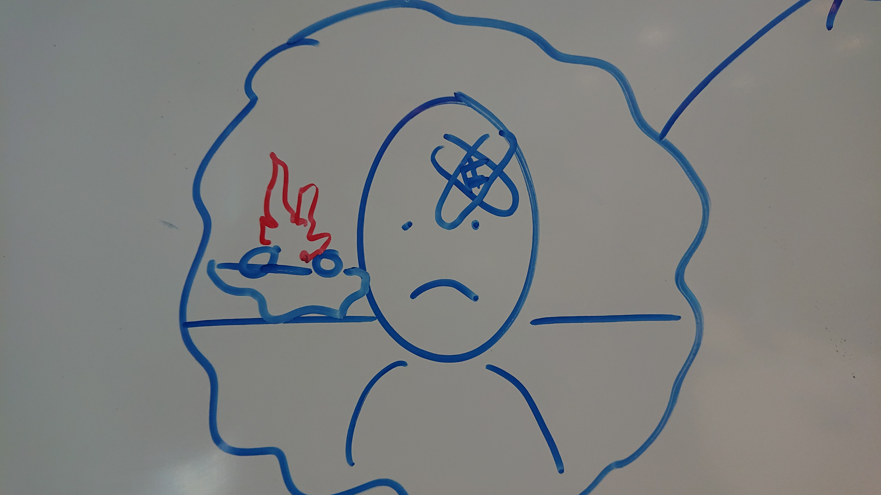

Slide 14
First take on making it scale

Slide 15
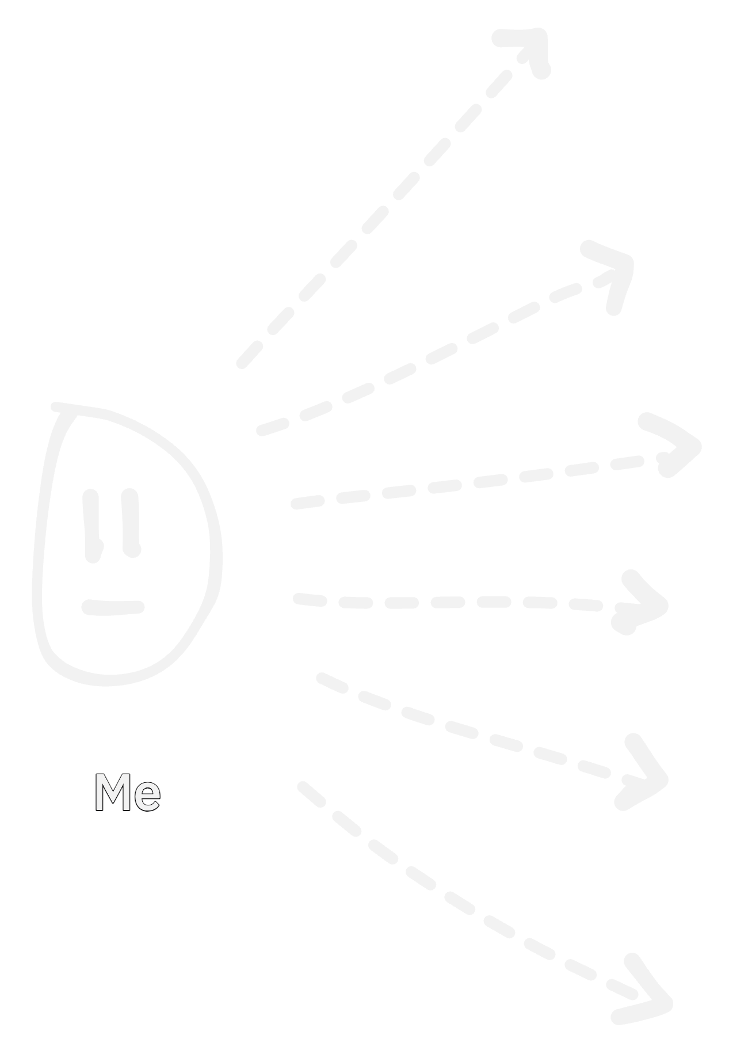
Notes:
I think drawing as a communication skill is a super power. And I want to teach a lot of people how to draw.

Slide 16
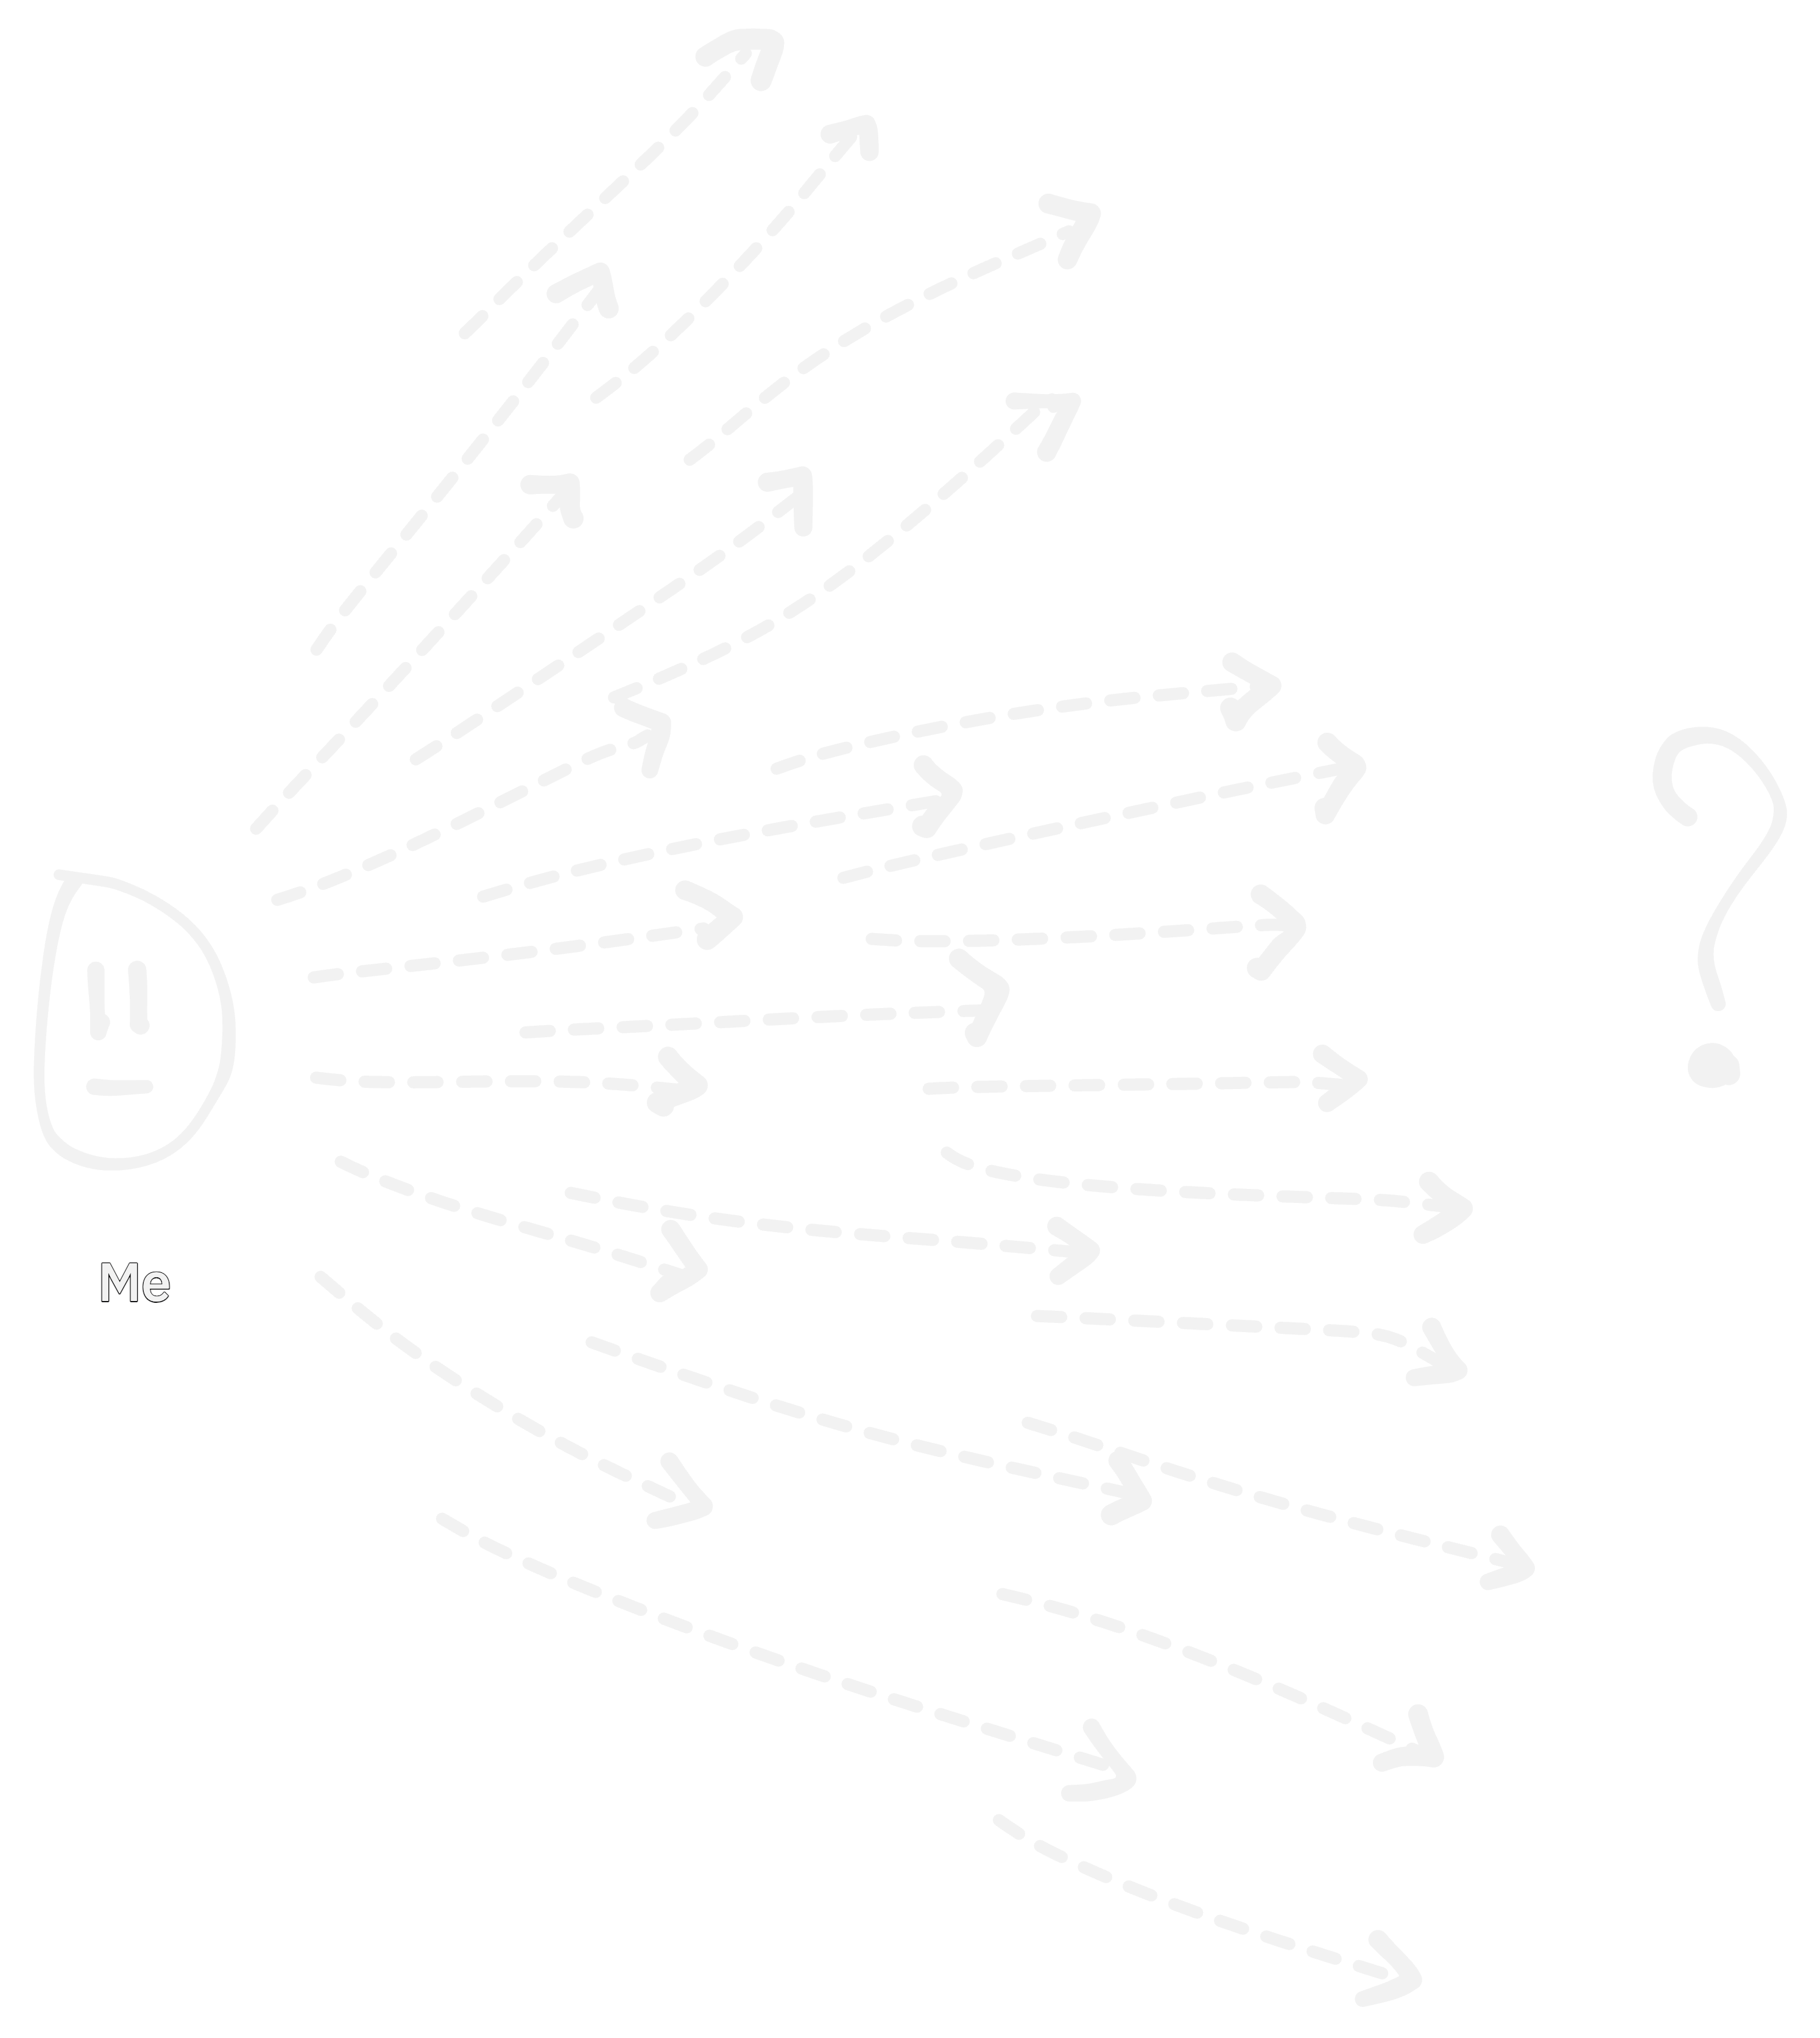
Notes:
Really a lot of people. But how?

Slide 17
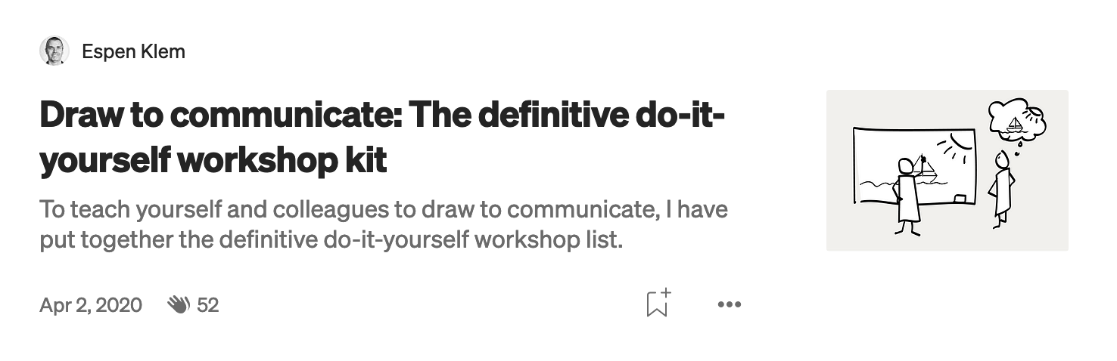
Notes:
I made a series of blogposts describing how to set ut a 4-part workshop for you and your colleagues. It was good to sharpen the ideas on what needed to go into the different workshops and how to communicate them.

Slide 18
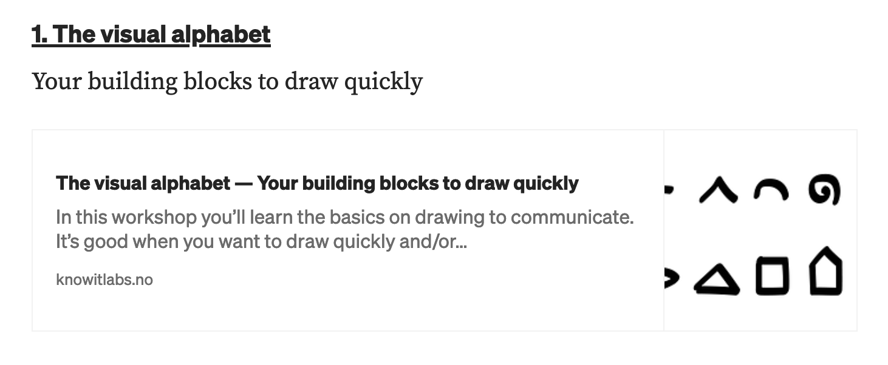
Notes:
Part 1 was jjust getting familiar with using the visual alphabet.

Slide 19
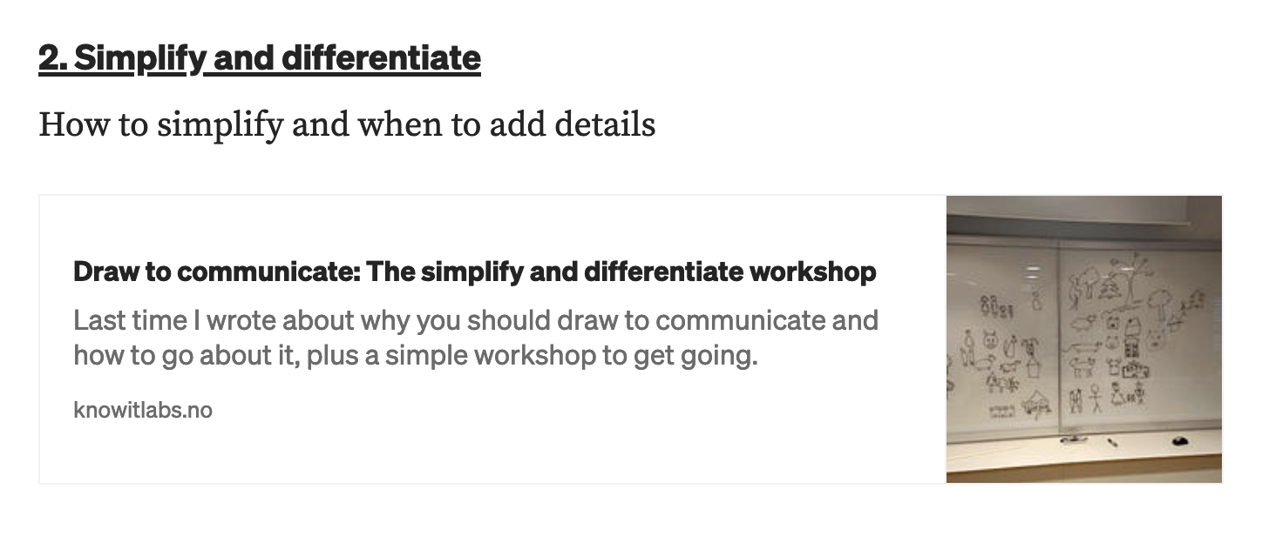
Notes:
Part 2 about how to draw simple enough to draw quick and also have the necessary details to make it communicate what you want.

Slide 20
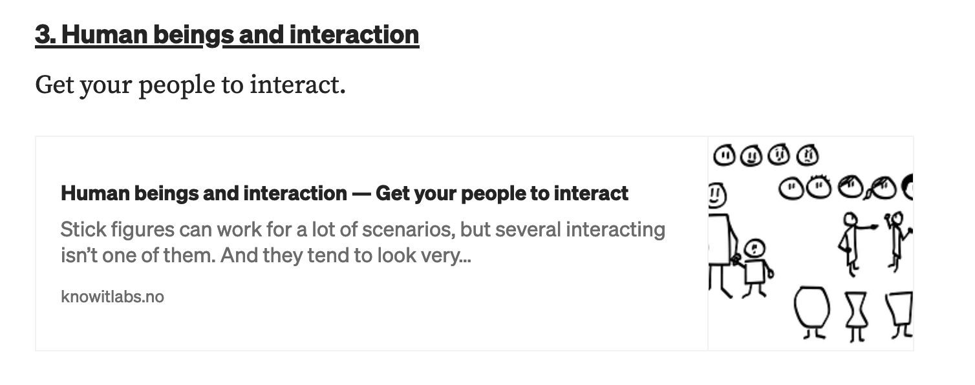
Notes:
Part 3 about how to draw human beings and interaction.

Slide 21
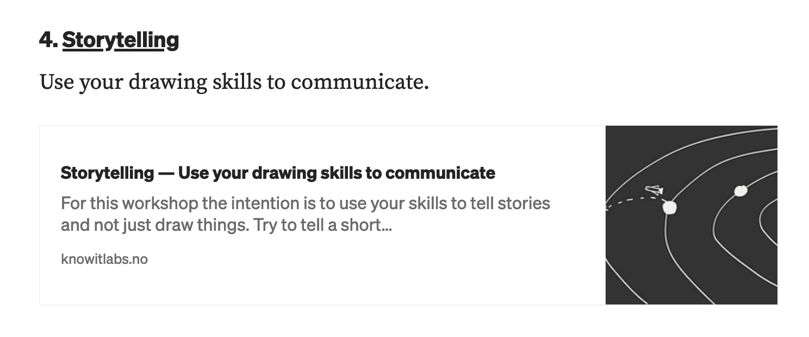
Notes:
Part 4, testing your skills, trying to tell stories through drawings. And part of communication is telling stories.

Slide 22
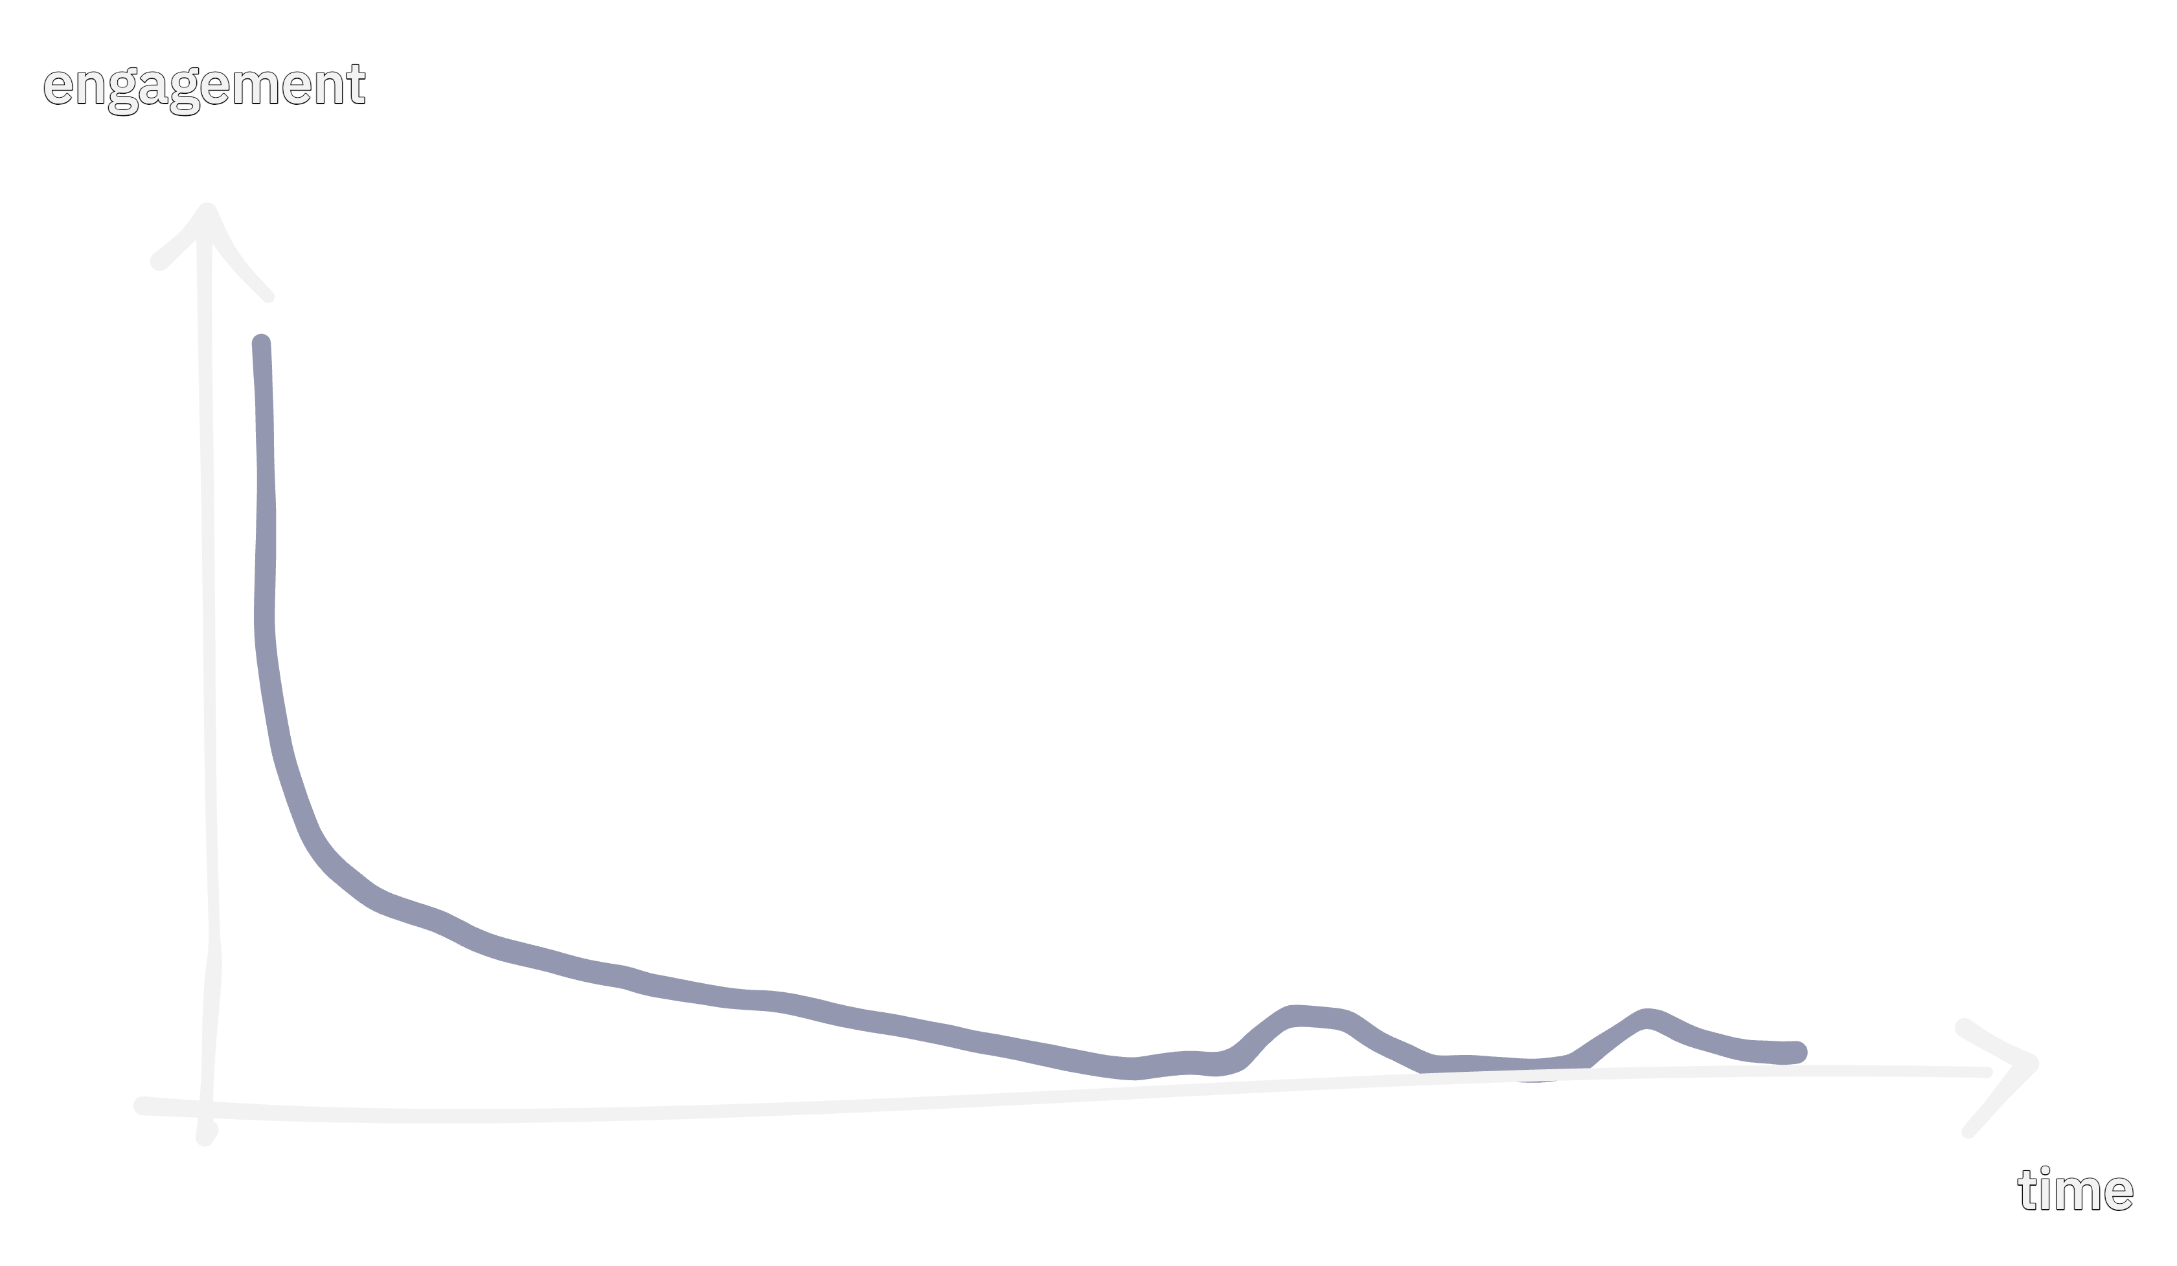
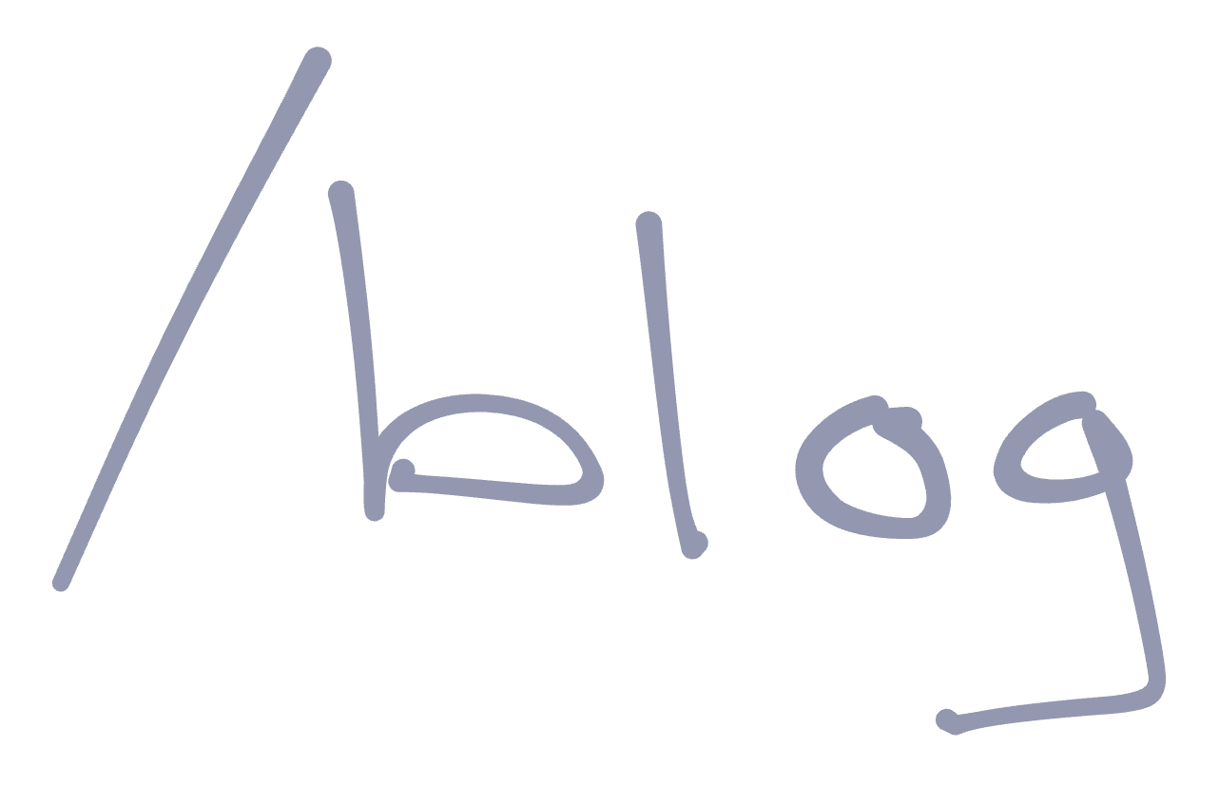
Notes:
Blogposts. They never reache a lot of people to begin with and really quickly, nobody read them at all. The volume of the long-tail is close to zero. It’s mostly the nature of blogposts.

Slide 23

Notes:
Also, I wanted people to go from a blogpost to somewhere not very concrete. A whiteboard, Miro, or something else of their choosing. You have to have a pretty convincing blogpost to manage that.
So a small fraction of all people will read the blog, and then a small fraction of that again would maybe try to run the workshop. The math isn’t very prosperous.

Slide 24
Covid: Online workshops in Miro - Still doesn't scale

Slide 25
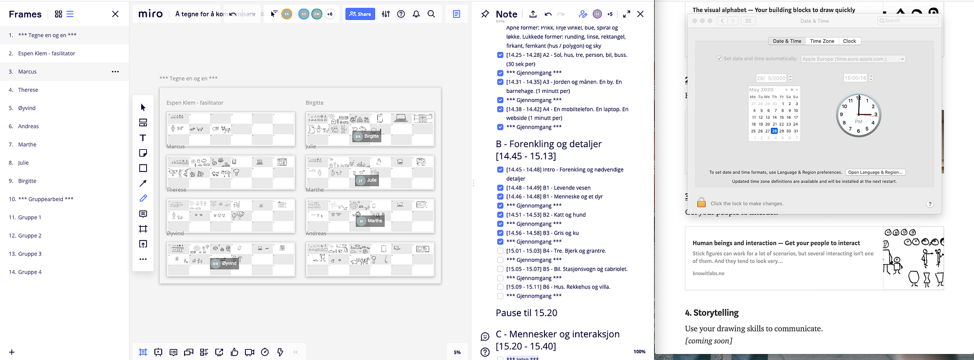
Notes:
Actually taught people to draw a little. But triggered very few to actually use drawing as a tool at work. Also, Miro doesn’t scale when everyone draws. Figured out that 10-12 people was max of what Miro could tolerate.

Slide 26
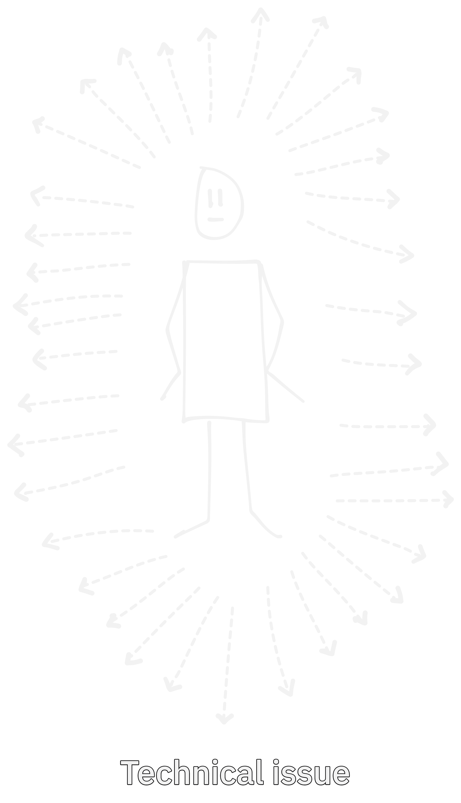
Notes:
How many you can communicate to one way is a technical issue. Miro failed at that, but does it really matter if we fix it?

Slide 27
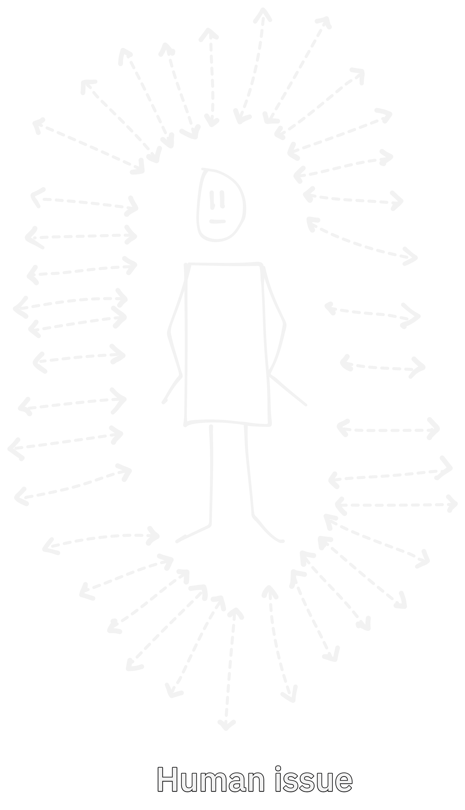
Notes:
Actual communication – two ways, is a human issue.

Slide 28
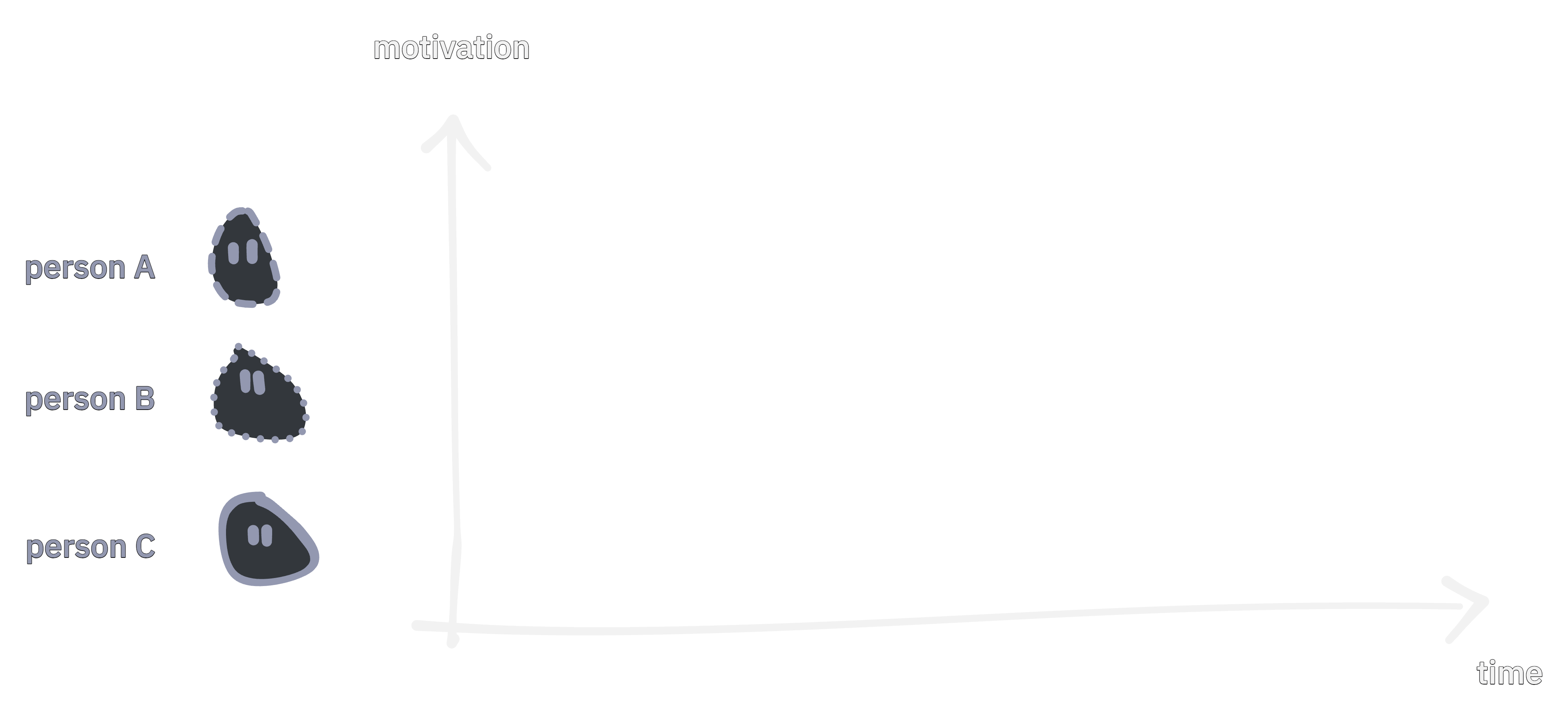
Notes:
In addition I think I mostly didn’t hit when people was motivated.

Slide 29
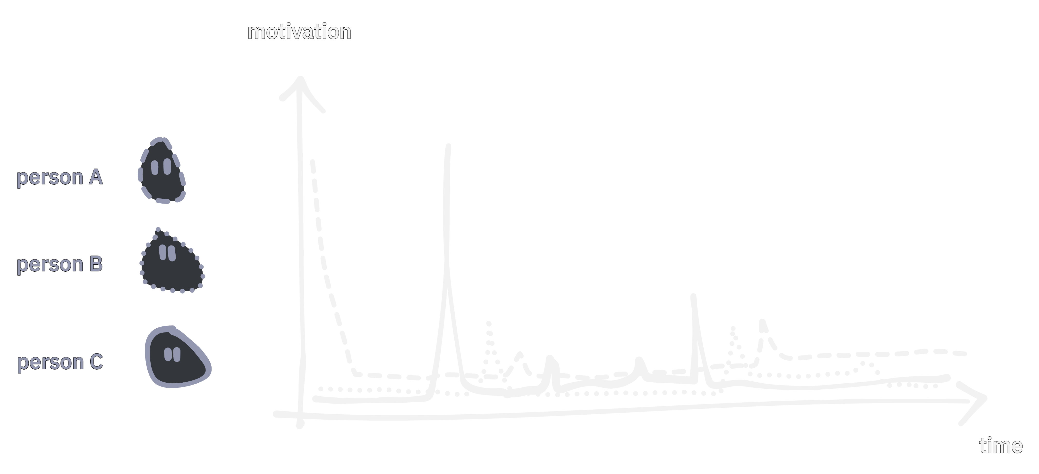
Notes:
People learn better when the see a usecase for what they are learning. That happens every now and then.

Slide 30
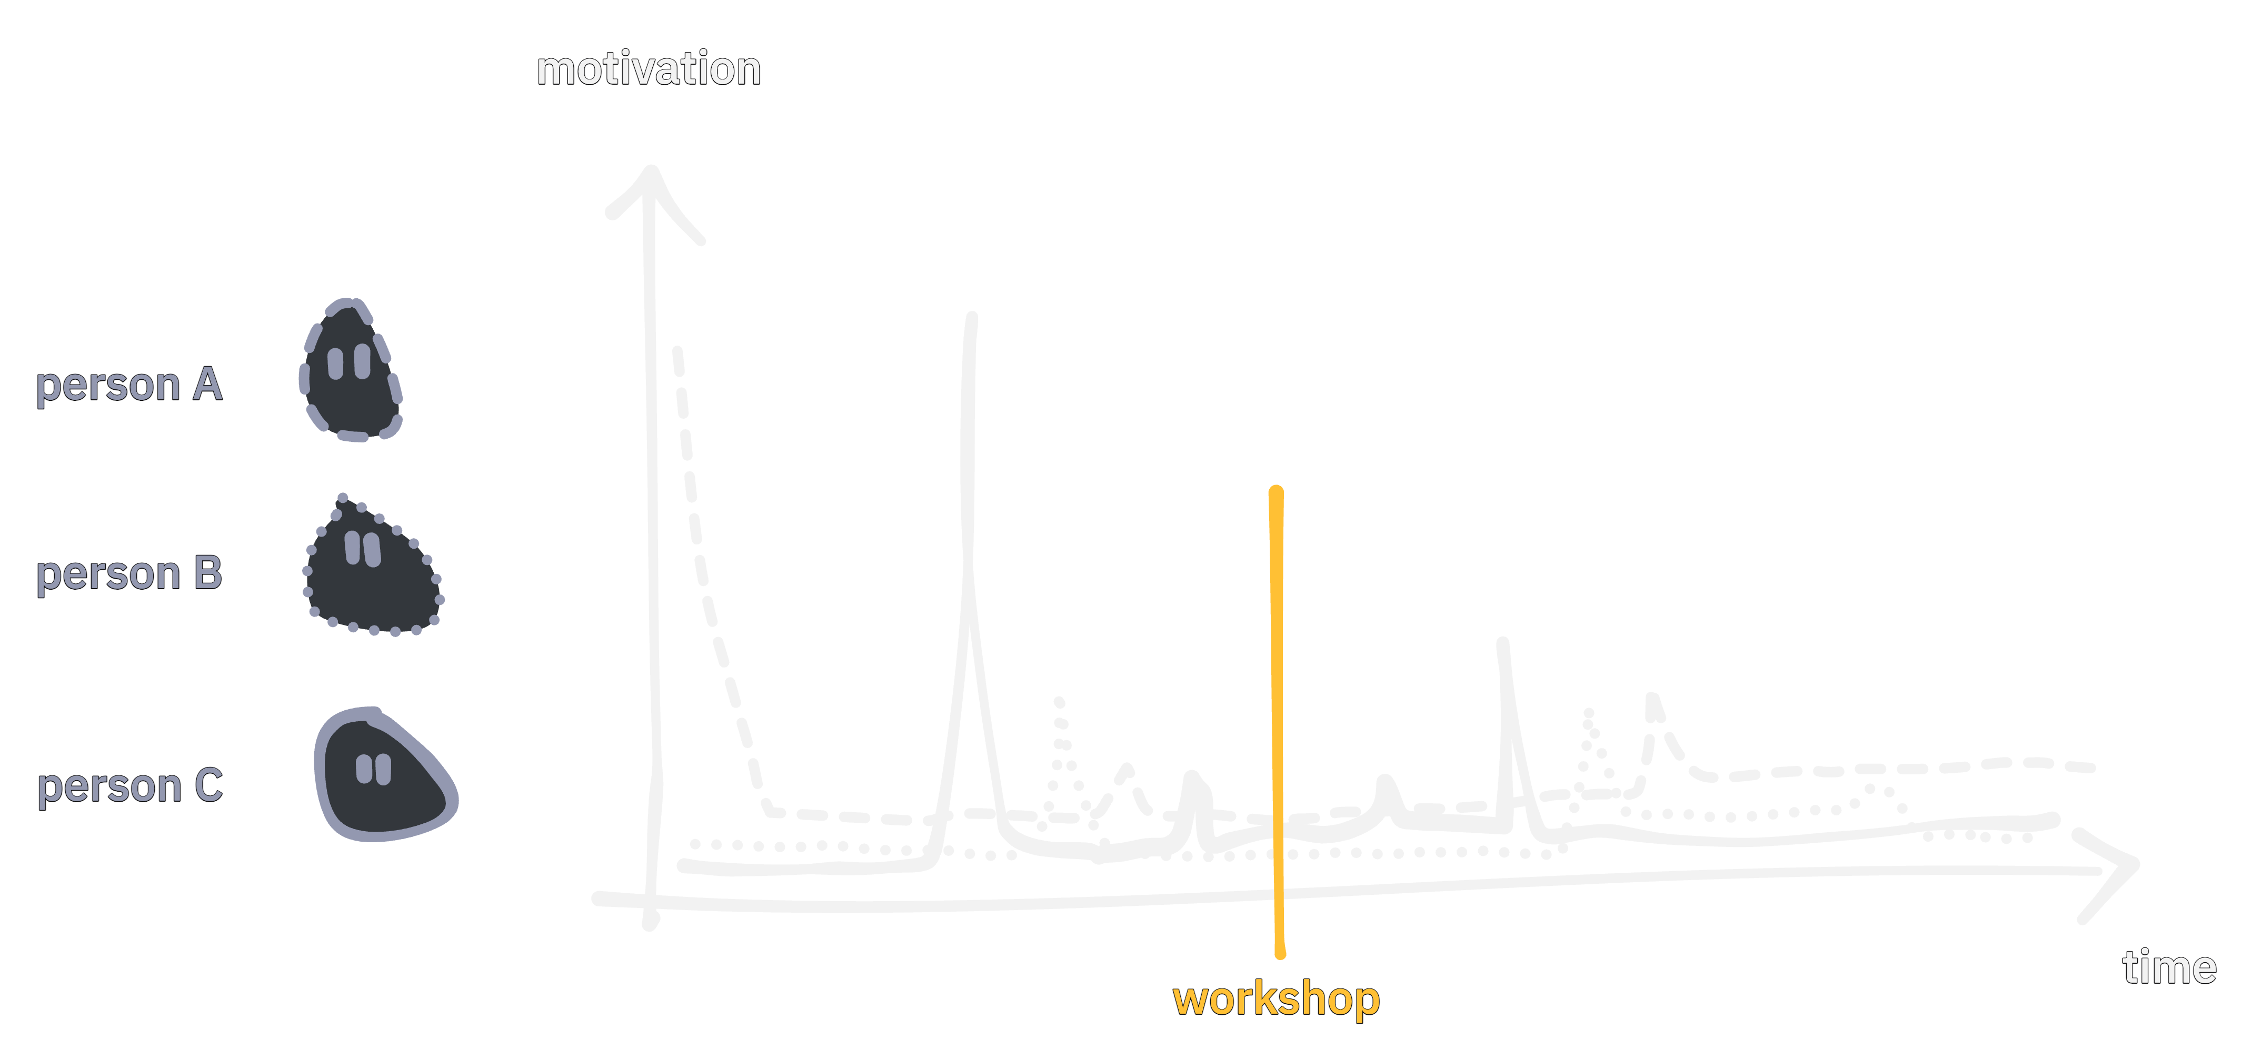
Notes:
And there is no way to hit that through a workshop set to a specific time.

Slide 31
How did I learn to draw
Notes:
Which brings me to how I learned to draw.

Slide 32

Notes:
* A colleague had been to a talk about the visual alphabet. Dave Gray – a presenter at Yggdrasil conference – Johannes Hoff Holmedahl

Slide 33
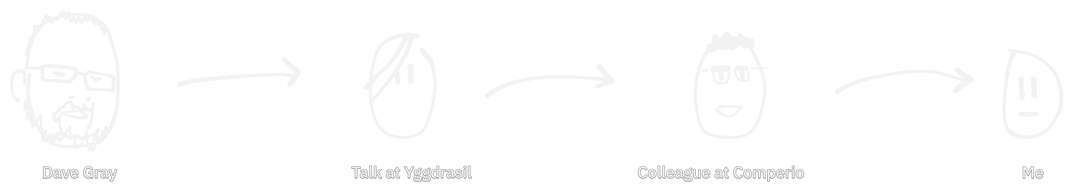
Notes:
* Presented it to his colleagues and the reason behind

Slide 34
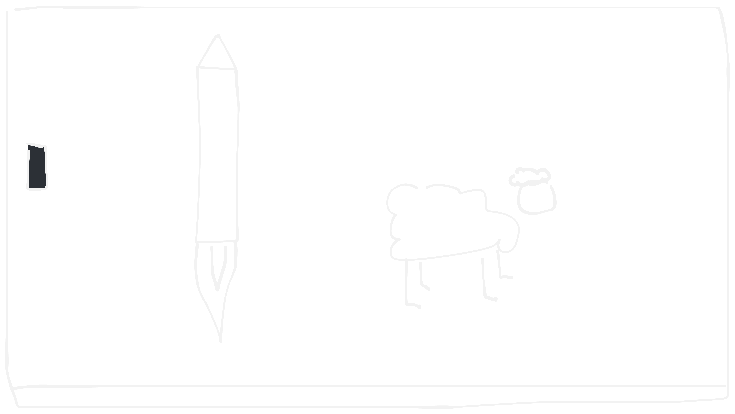
Notes:
We challenged each other to use the visual alphabet to draw different things. And it worked. But we didn’t draw anything for actual work.

Slide 35
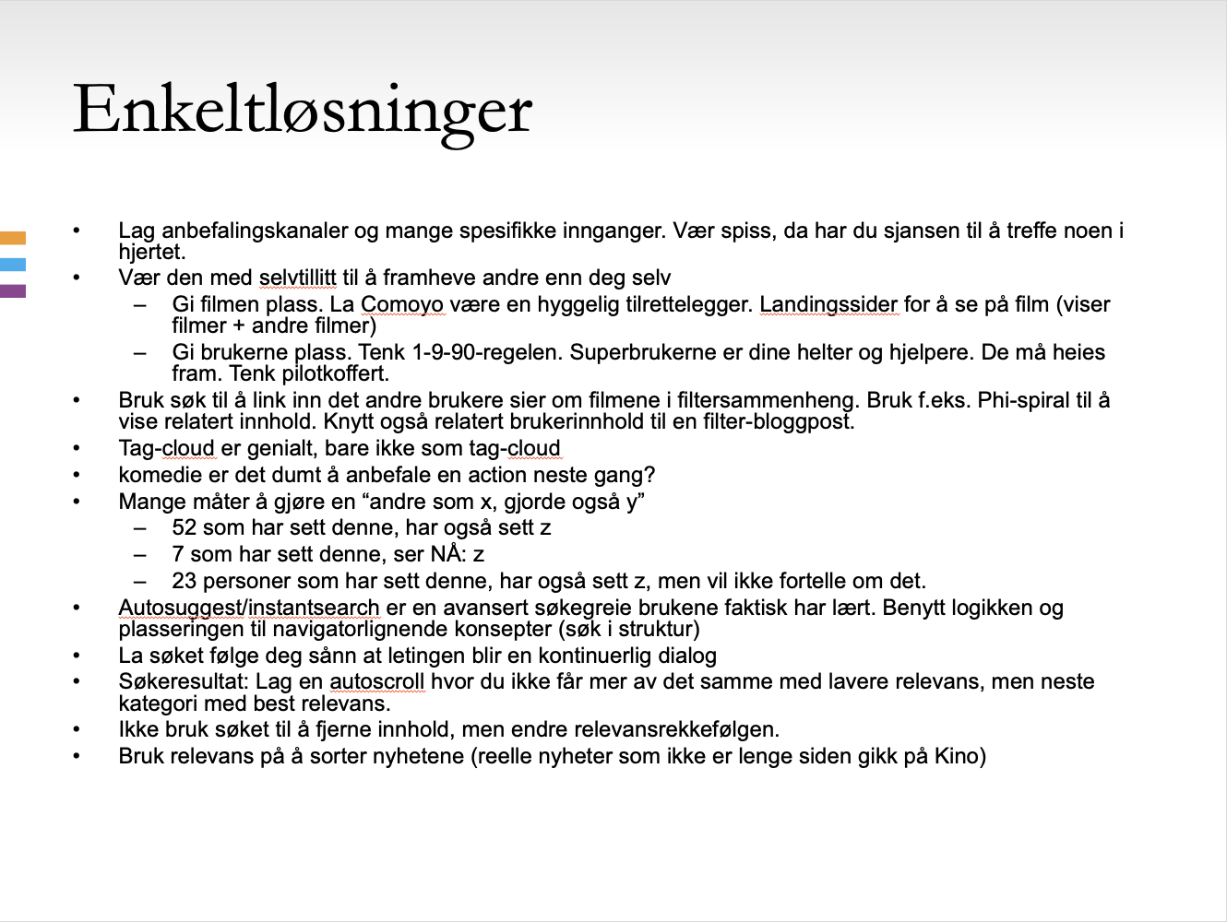
Notes:
Then I had a pitch to a potential customer that I wanted to make. After a lot of pain and text heavy slides with notes I started to draw.

Slide 36
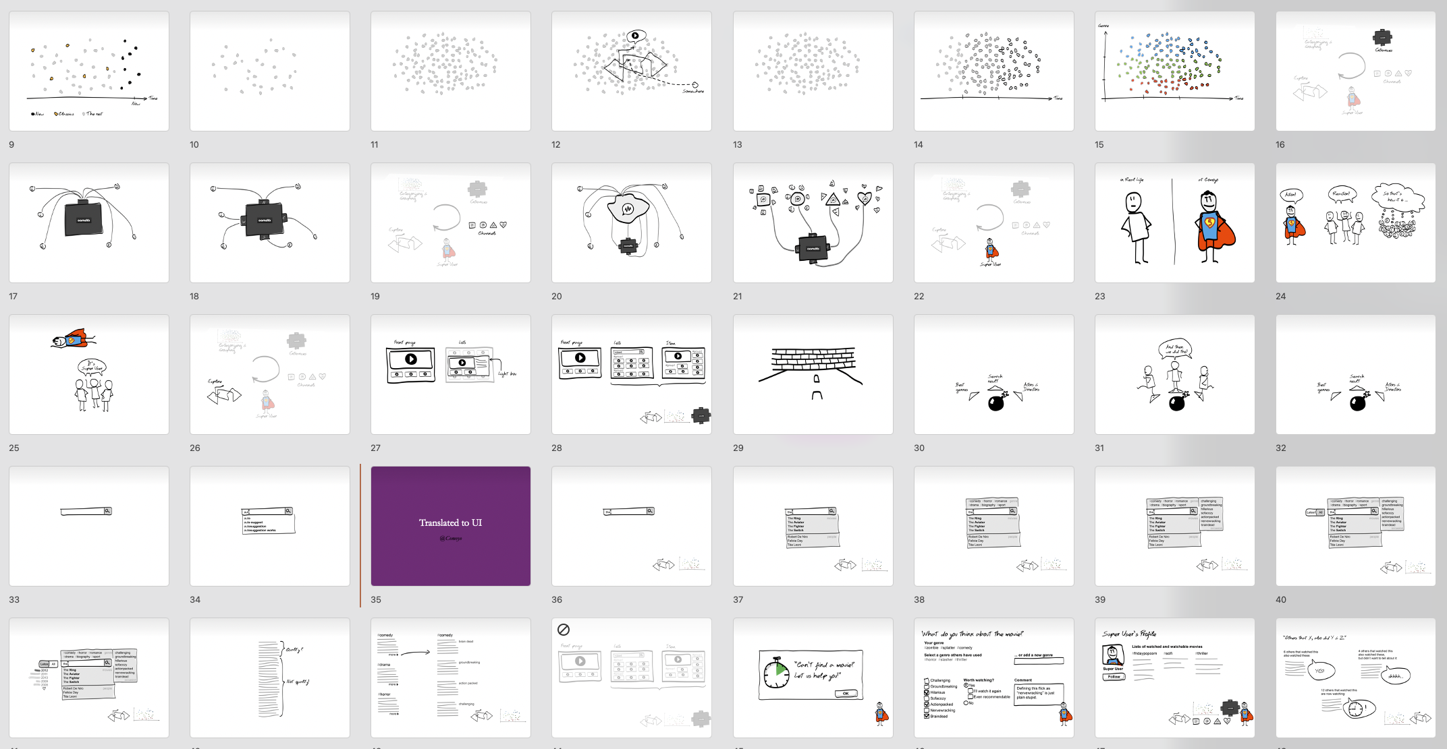
Notes:
It became a 40-page cartoon, telling a story.

Slide 37
How to make it more useful?
Notes:
Design critique

Slide 38
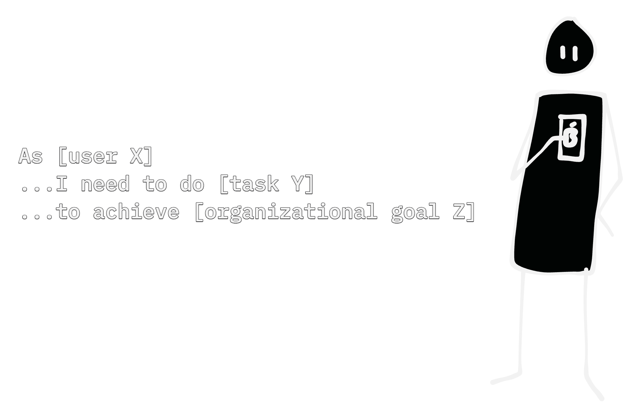
Notes:
Start with a problem you want to describe and/or solve. Maybe a user story, or something else.

Slide 39
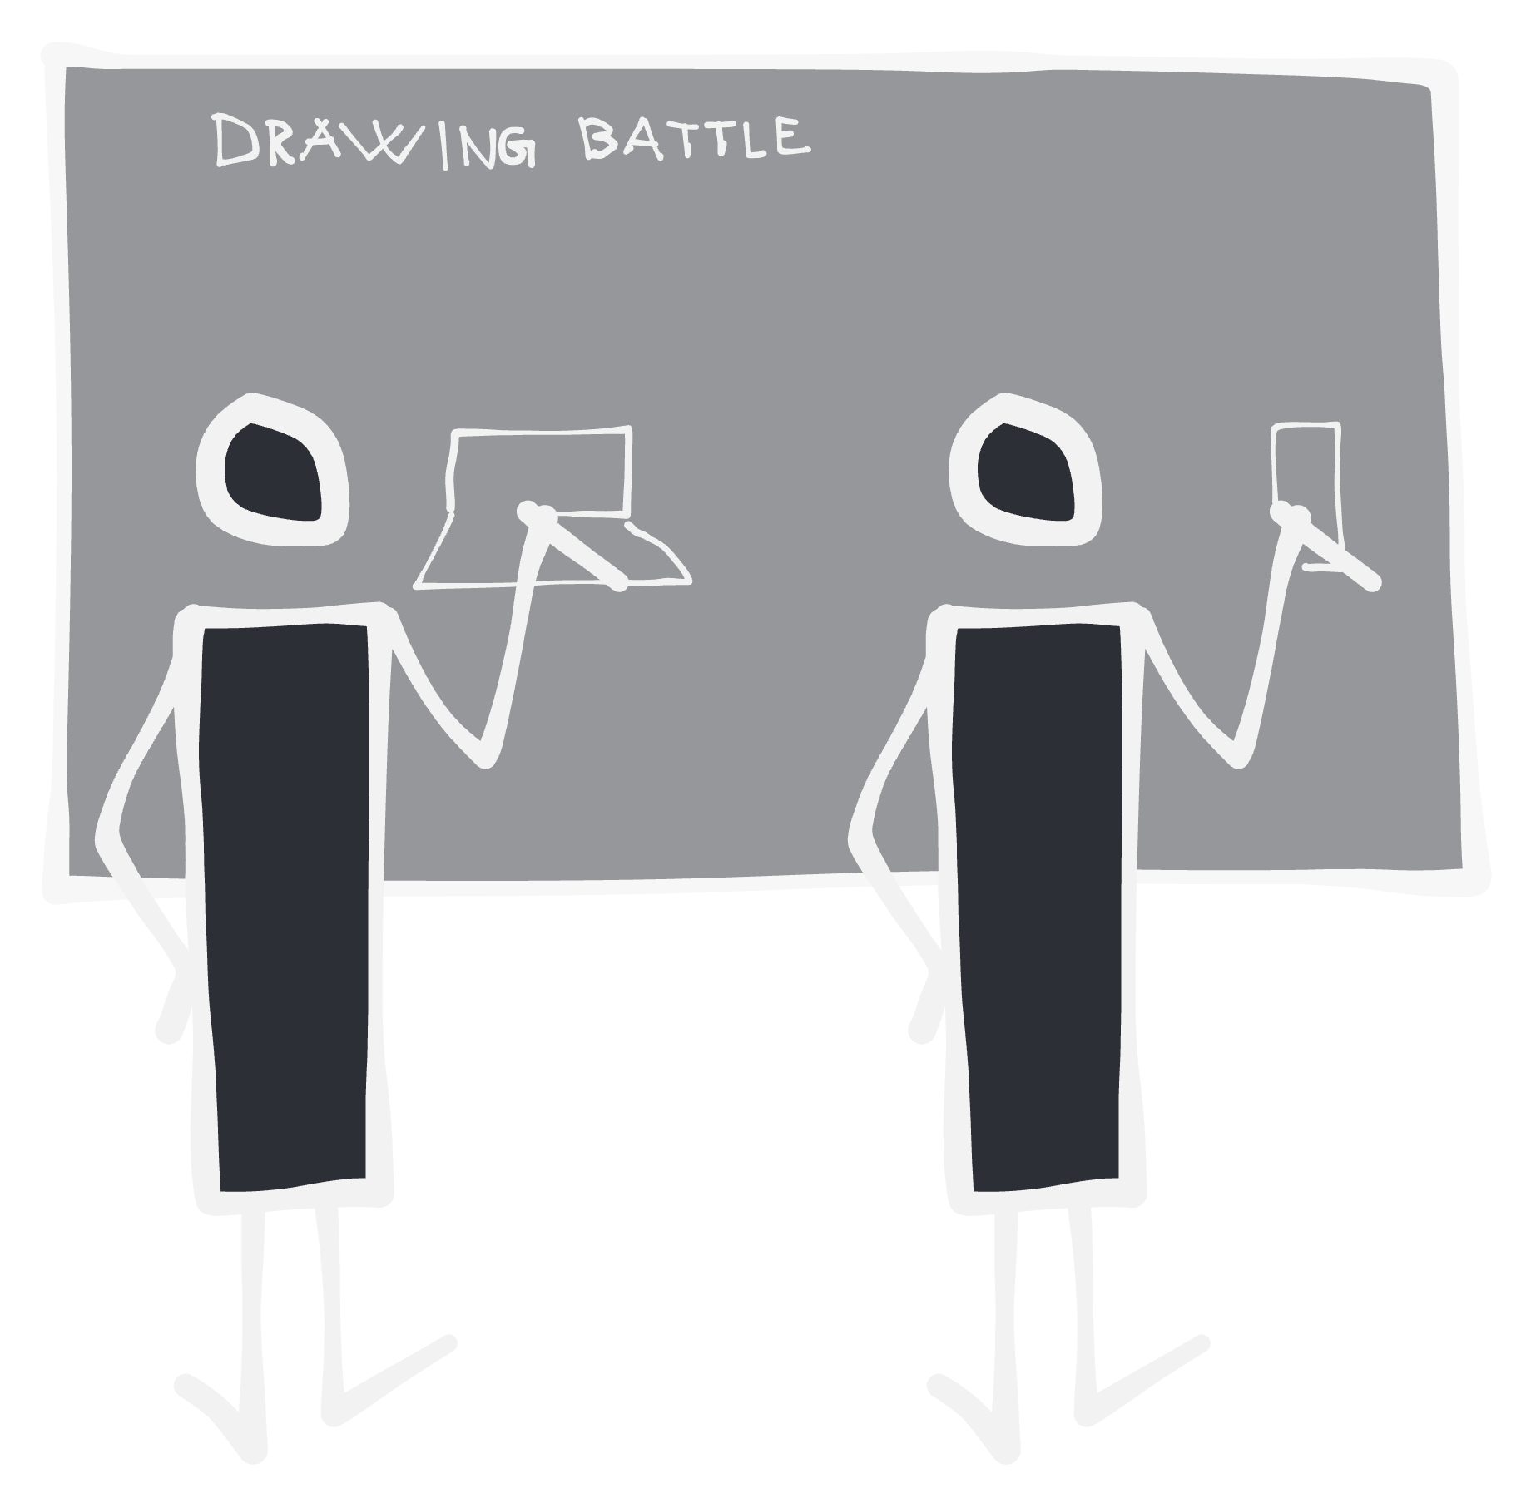
Notes:
Do a drawing battle. Everyone draws.

Slide 40
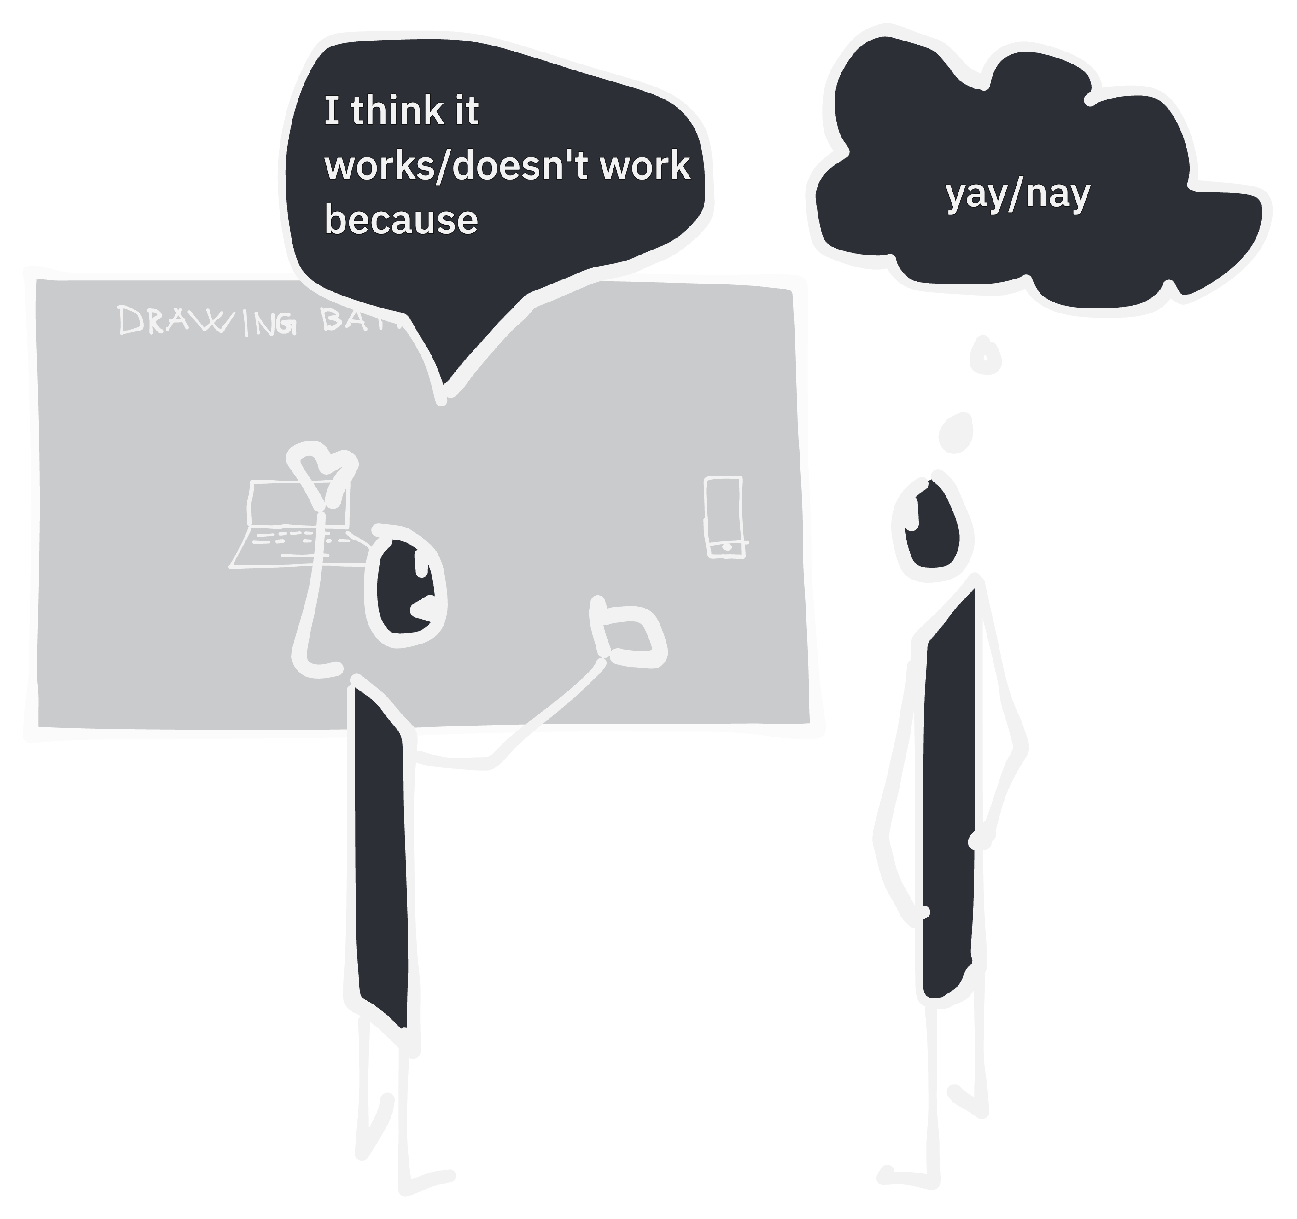
Notes:
Design critique is a really powerful discussion technique.
Describe what you think works or doesn’t work with the other persons drawing. And why.
It’s up to the recipient what you want to take away from the input. You can change course or double down on trying your initial solution or description.

Slide 41
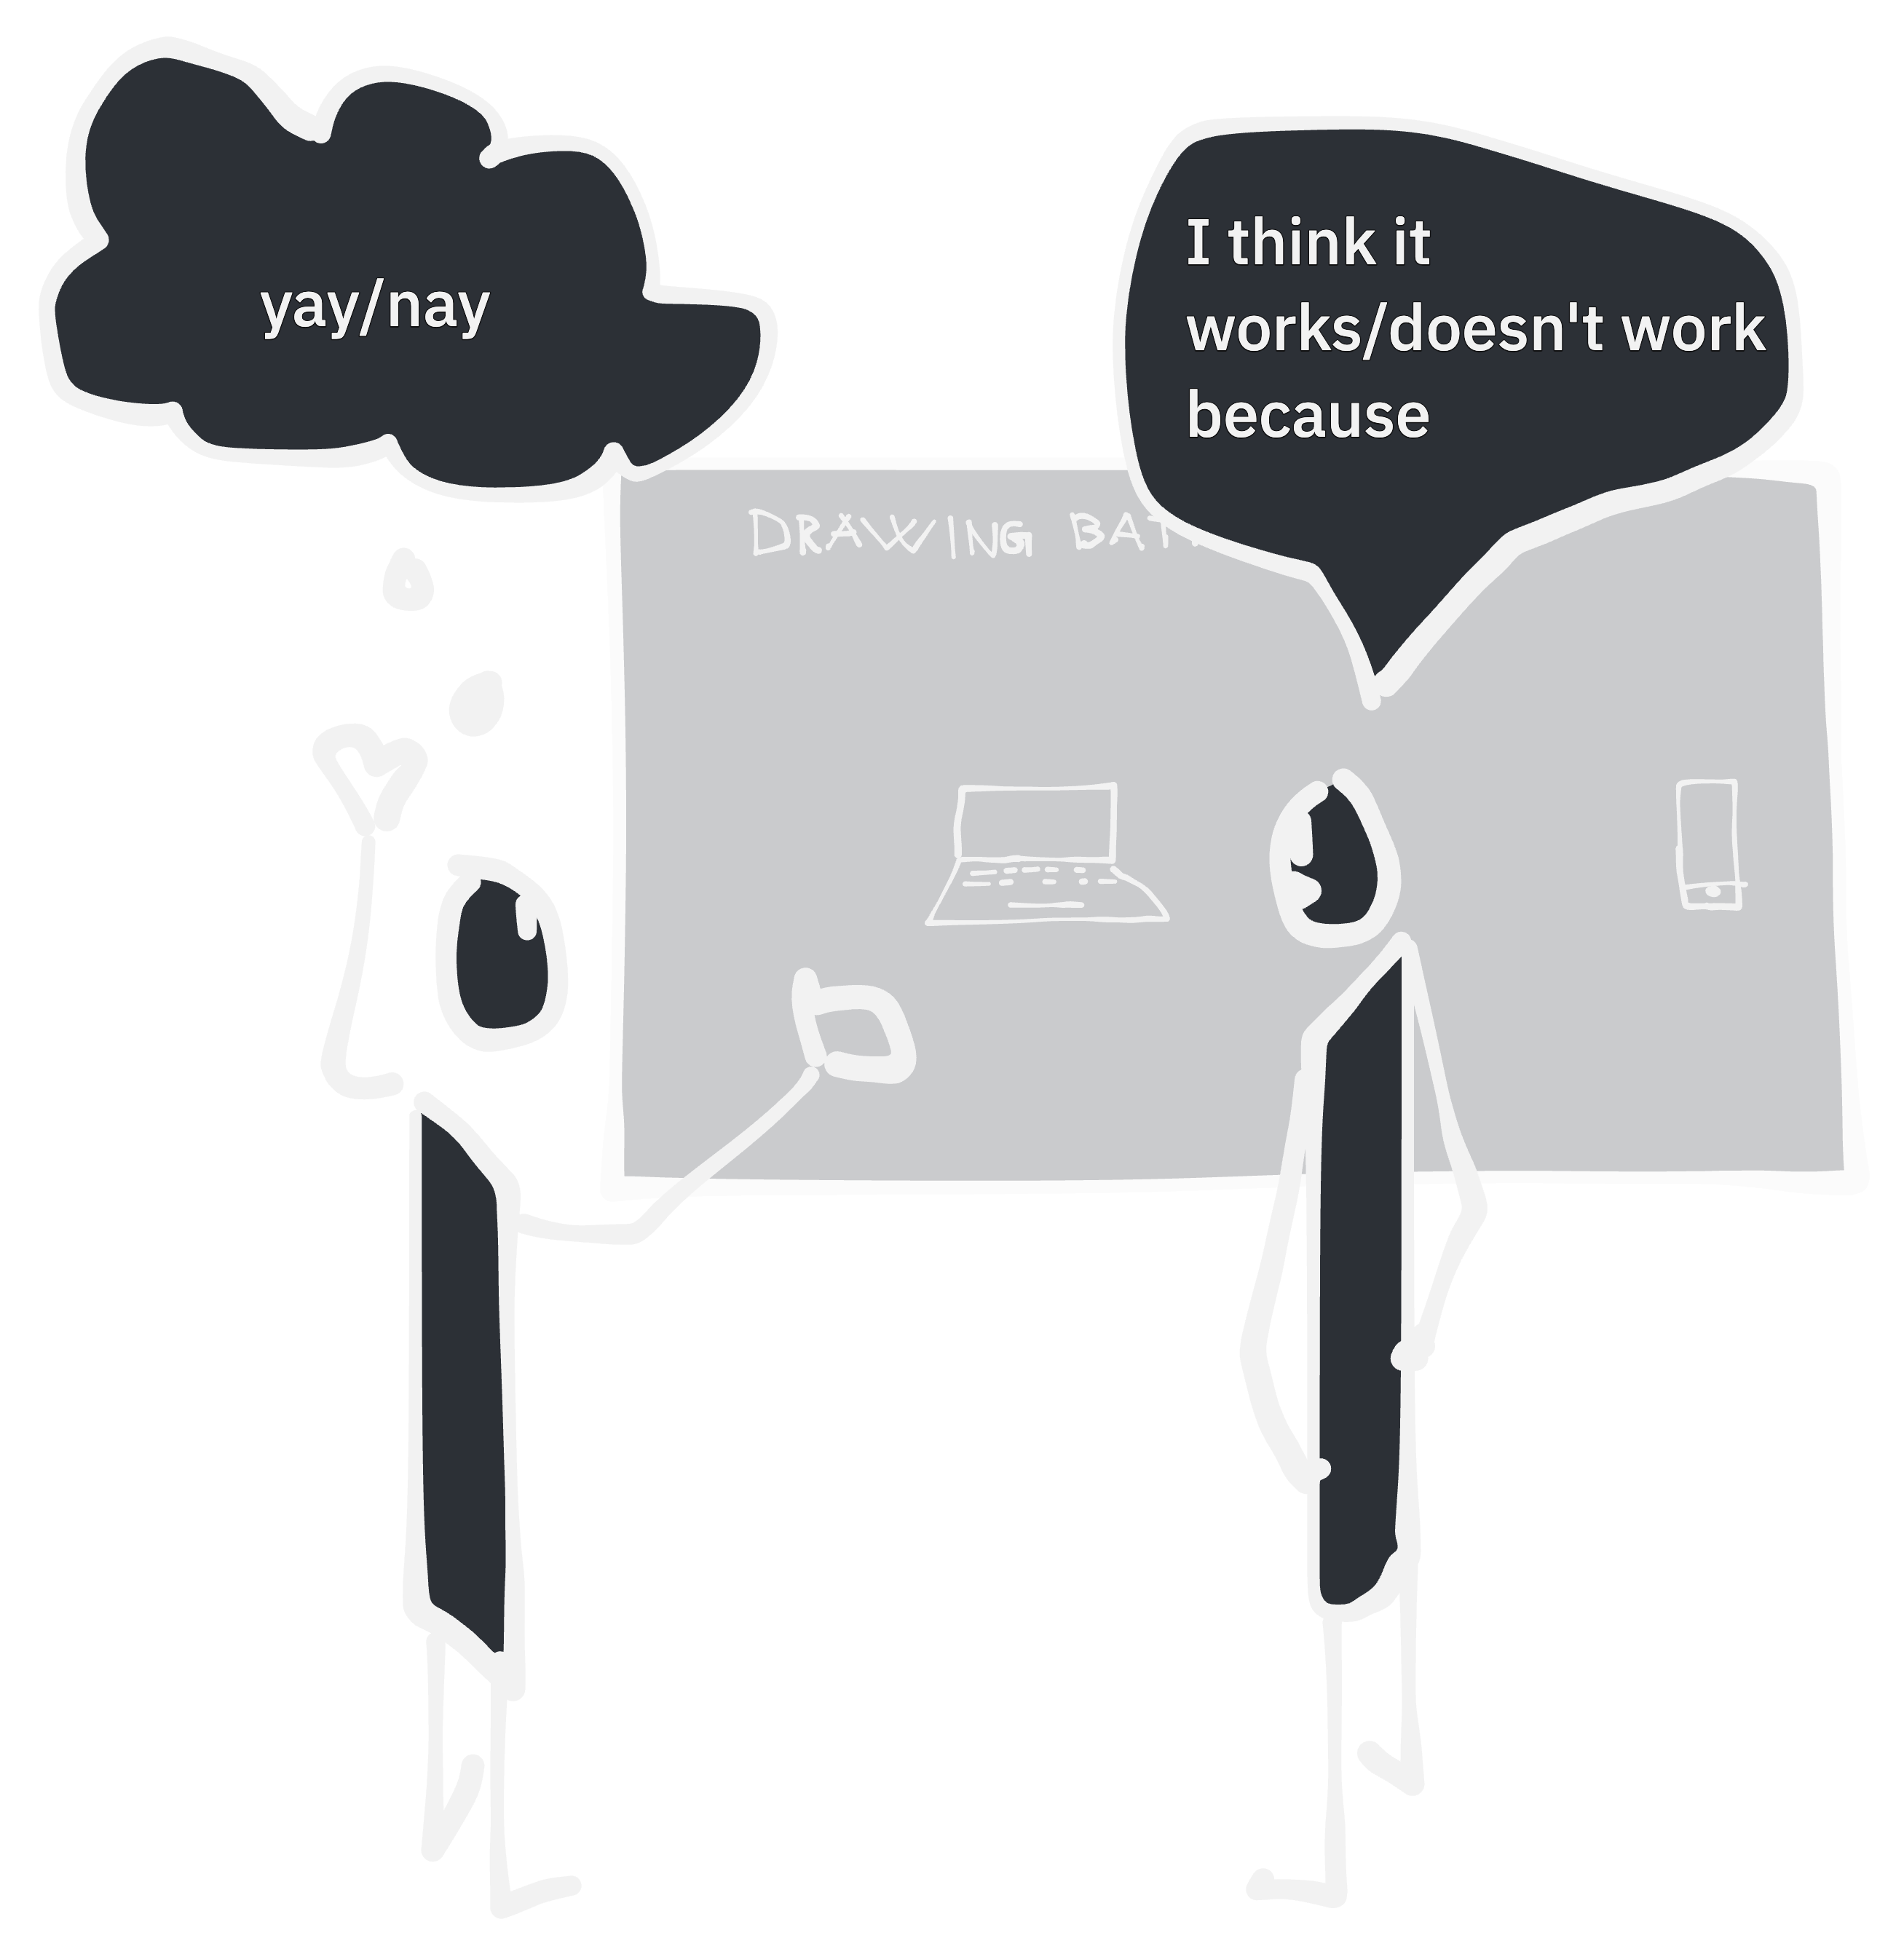
Notes:
Do this for every participant in the drawing battle.

Slide 42
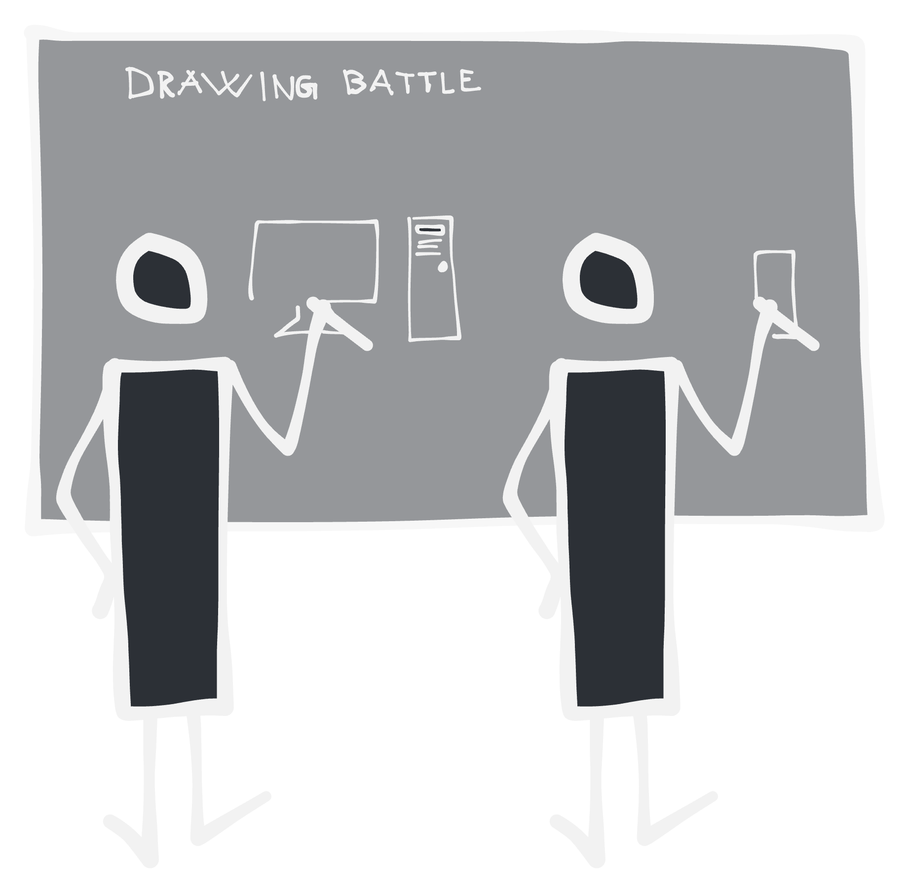
Notes:
You get to challenge your own ideas in your own tempo.

Slide 43
What the future may hold

Slide 44
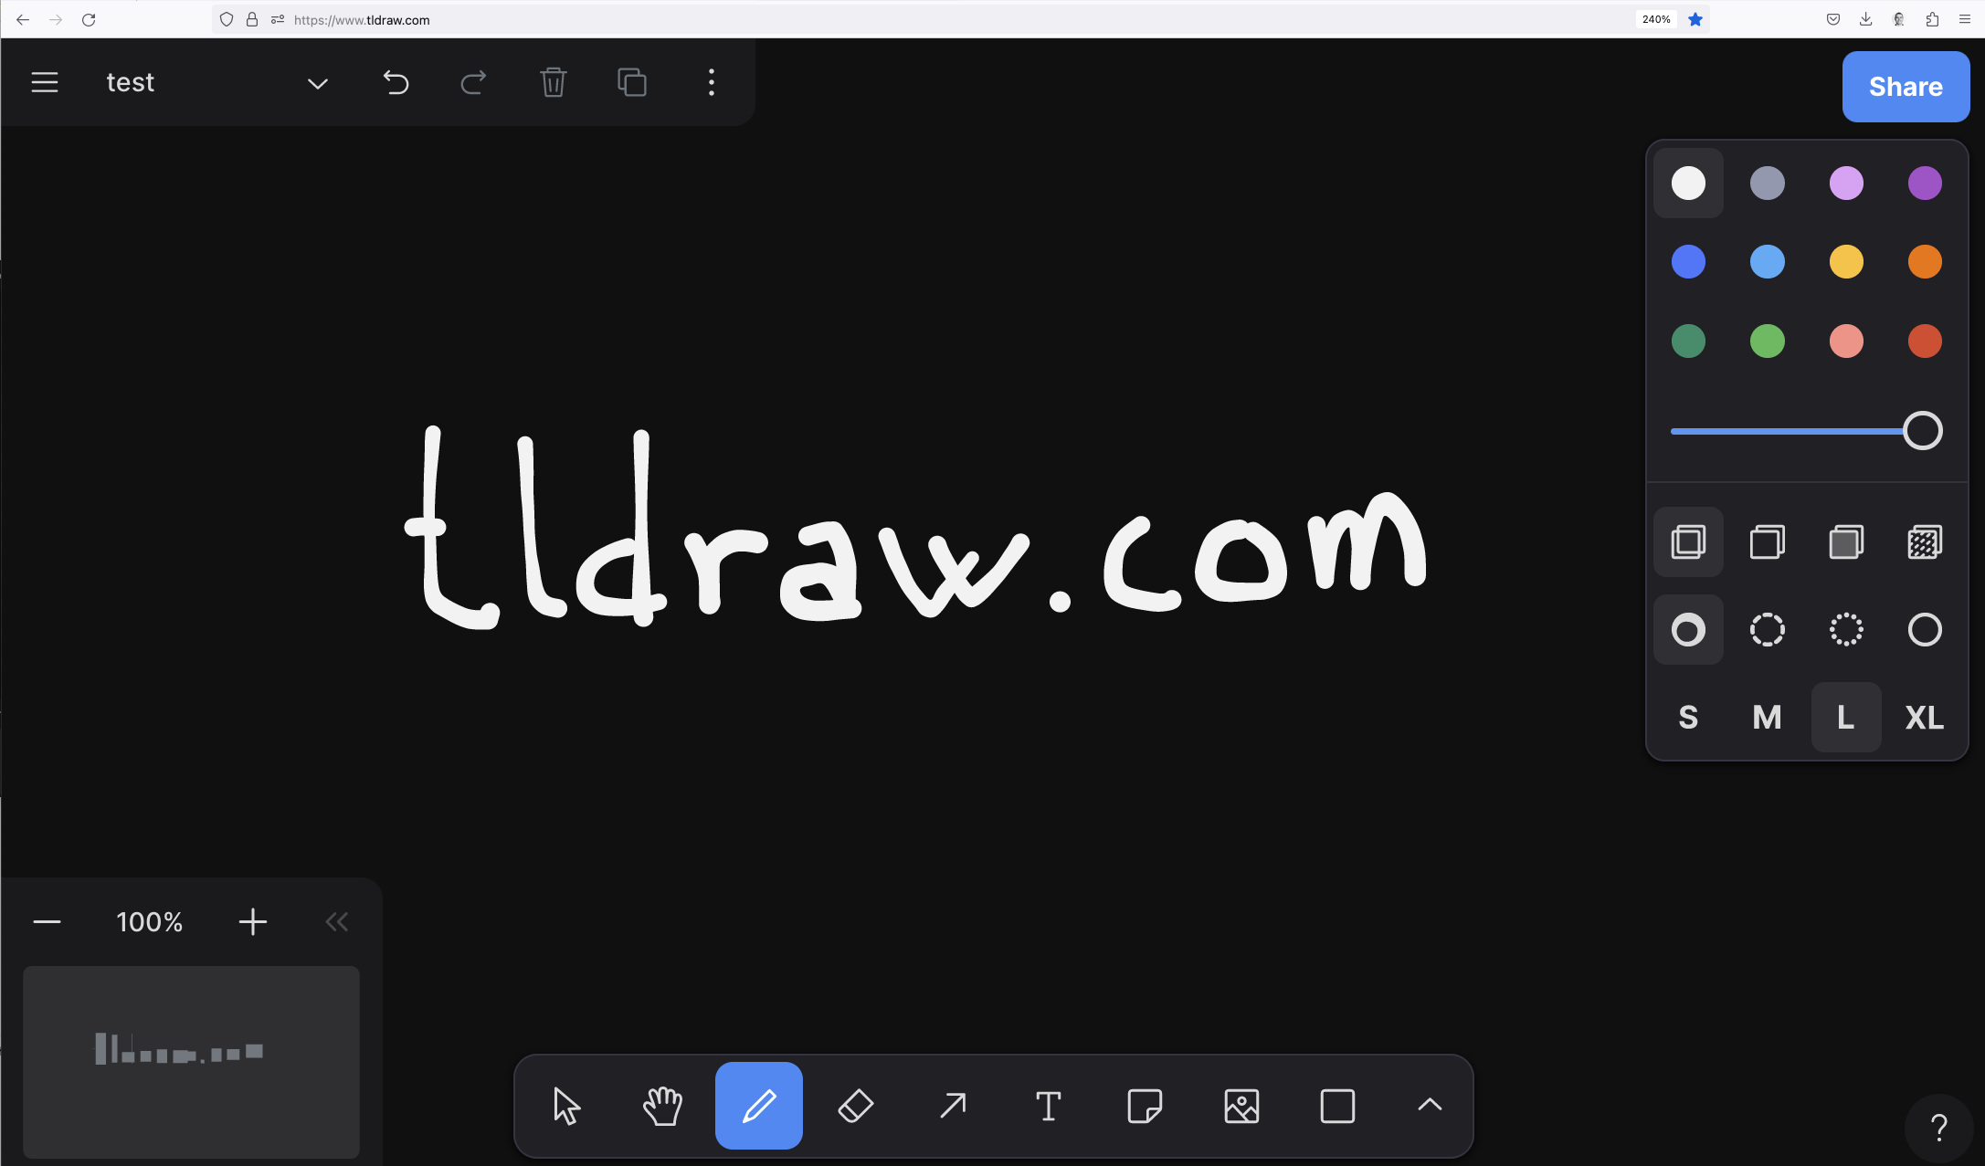
Notes:
Online, self service workshops through tldraw.com – Tiny little drawing app
Got all you need: * zoom
* panning
* endless canvas
* drawing pen with different thicknes and some colors. You don’t need a lot more.

Slide 45
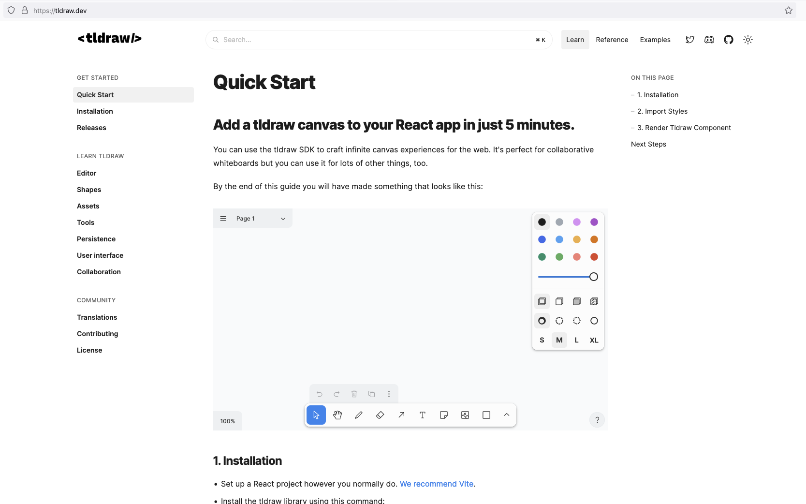
Notes:
A big difference between Miro and Tldraw is that you can build on top of Tldraw and create your own webapps.
And you have quite thorough descriptions as to how. It was opensource, now it’s only free if what you make is free to. No problem for me.

Slide 46
Notes:
What I have done is to start translating the manned Miro workshop into...

Slide 47
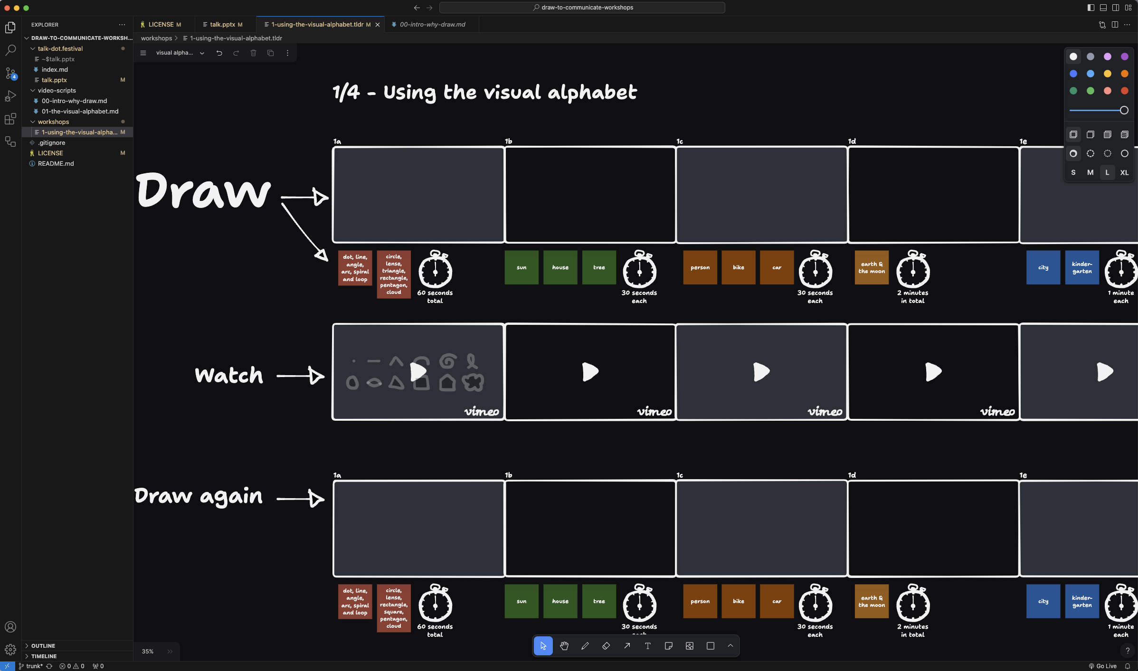
Notes:
... a self service workshop in tldraw.
Basically the setup is that you:
draw something
watch how it could be done
draw again if you got some new ideas

Slide 48
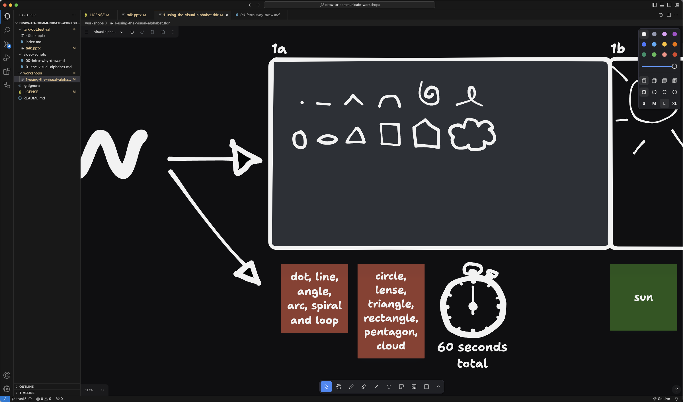
Notes:
Each board has a set of things you should draw and how long it should take.
I have yet to create the videos, but then I’ll start sharing a bit more public.

Slide 49
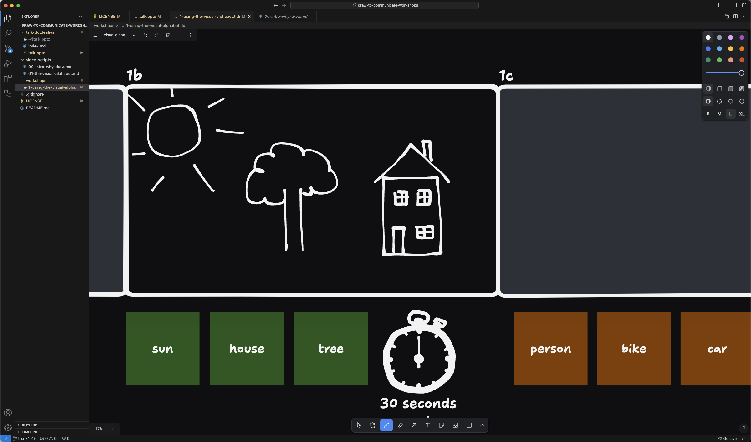
Notes:
The first workshop part takes you from childrens drawings...

Slide 50
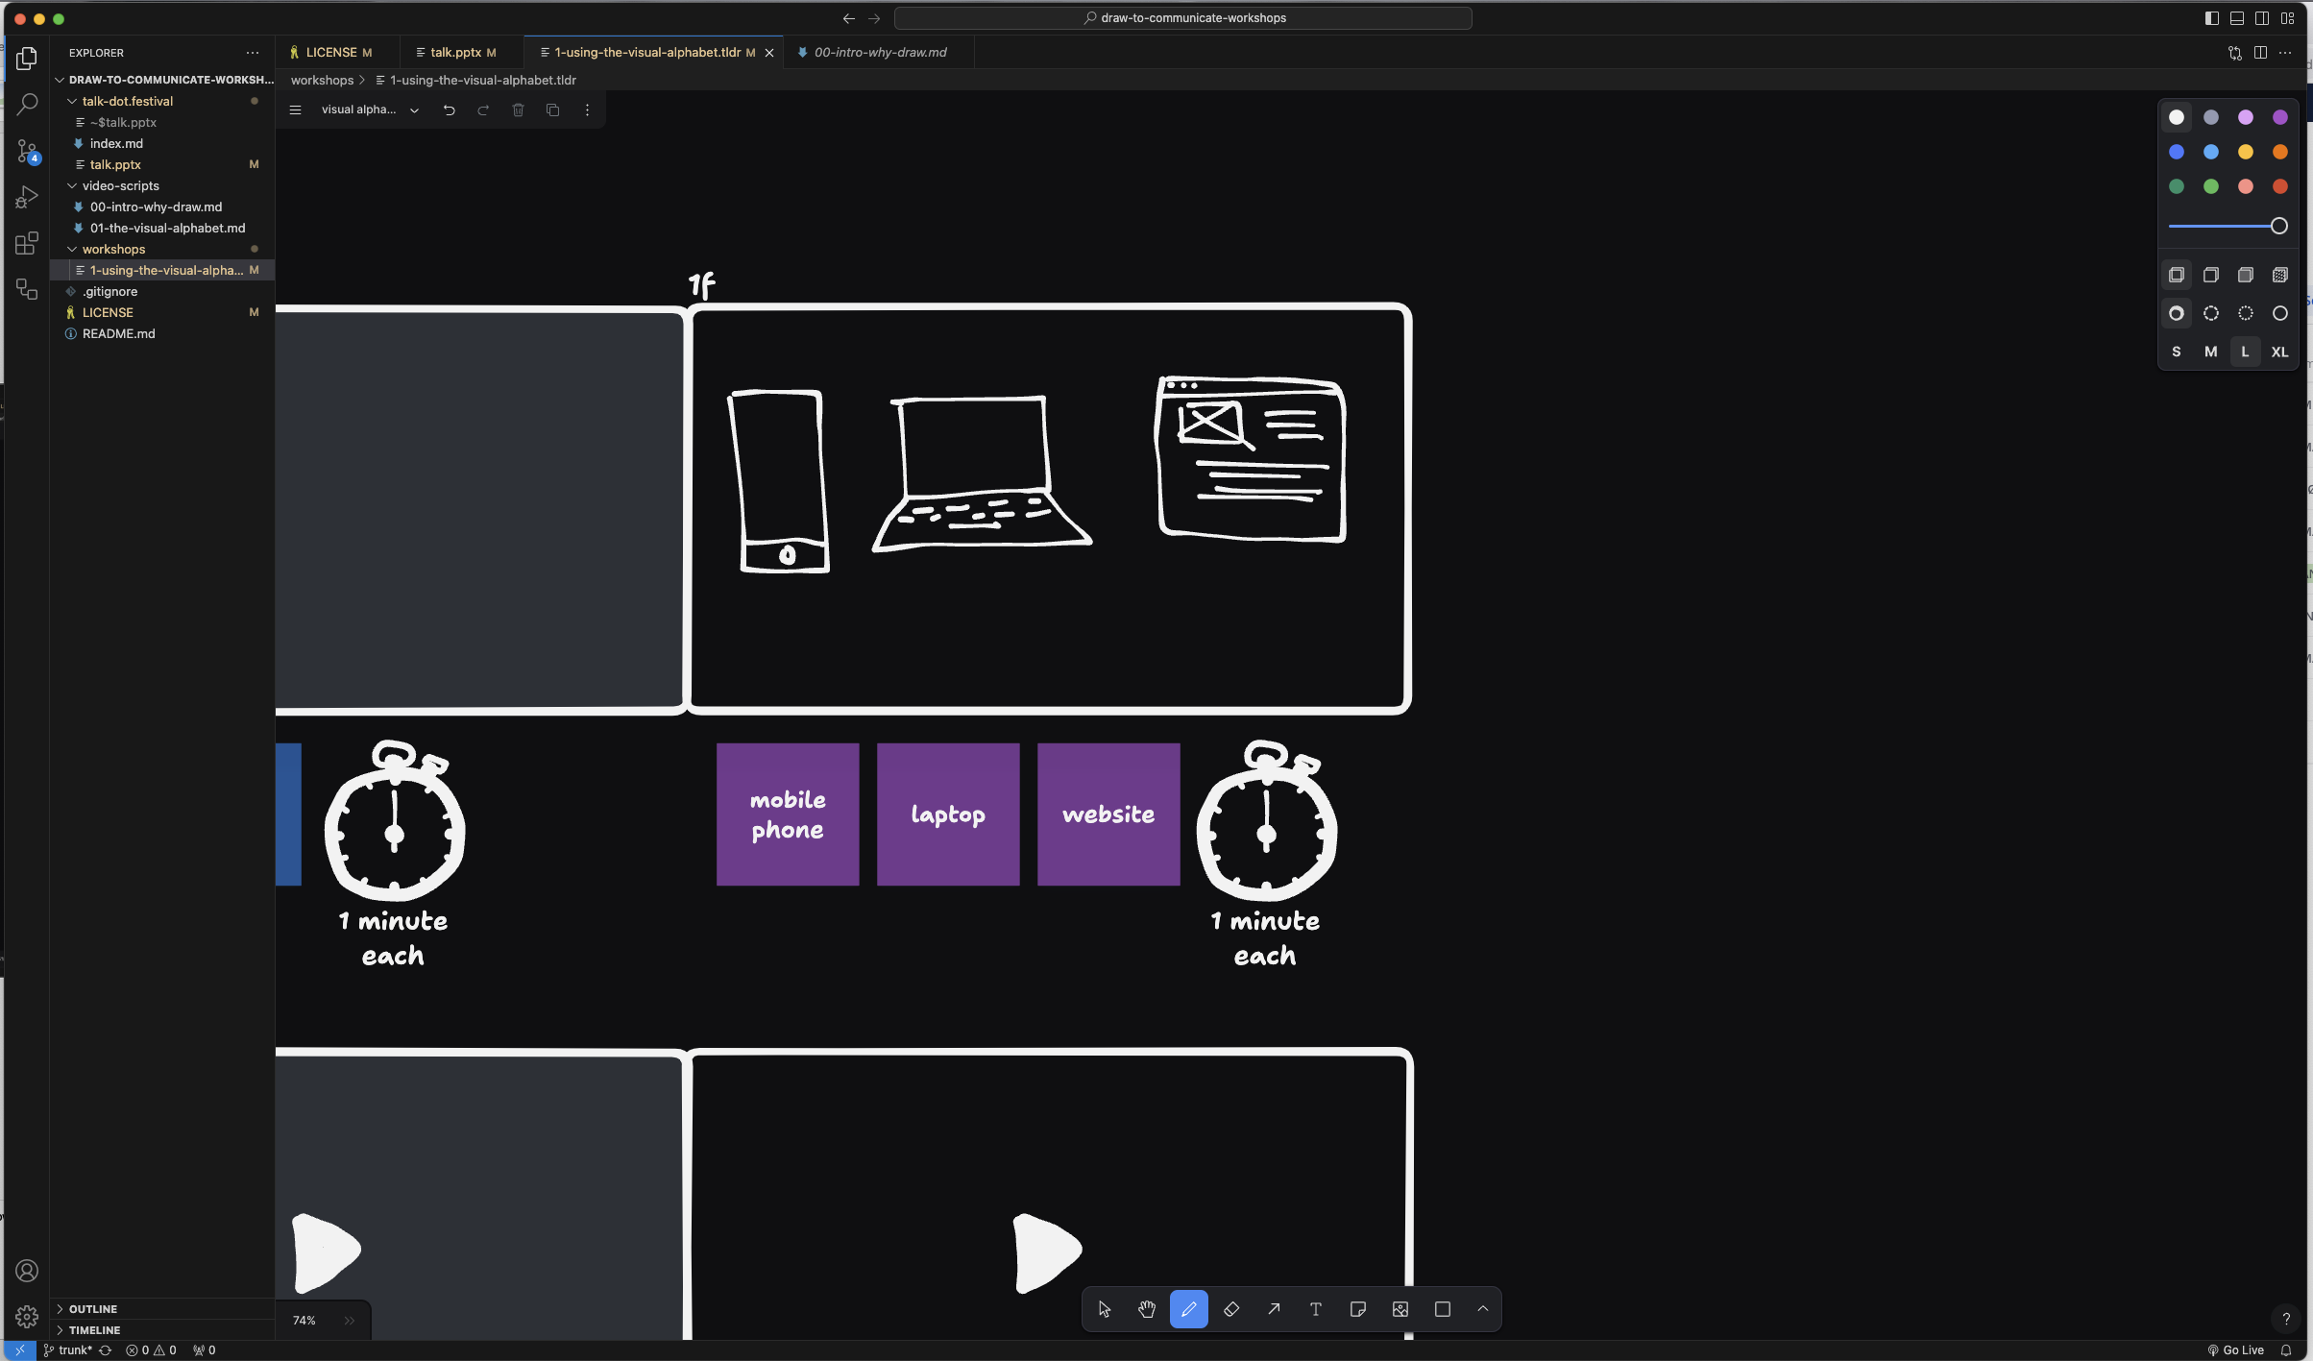
Notes:
... to something closer to usefull in our line of work.
But the first workshop part is still mostly to practice using the visual alphabet.

Slide 51
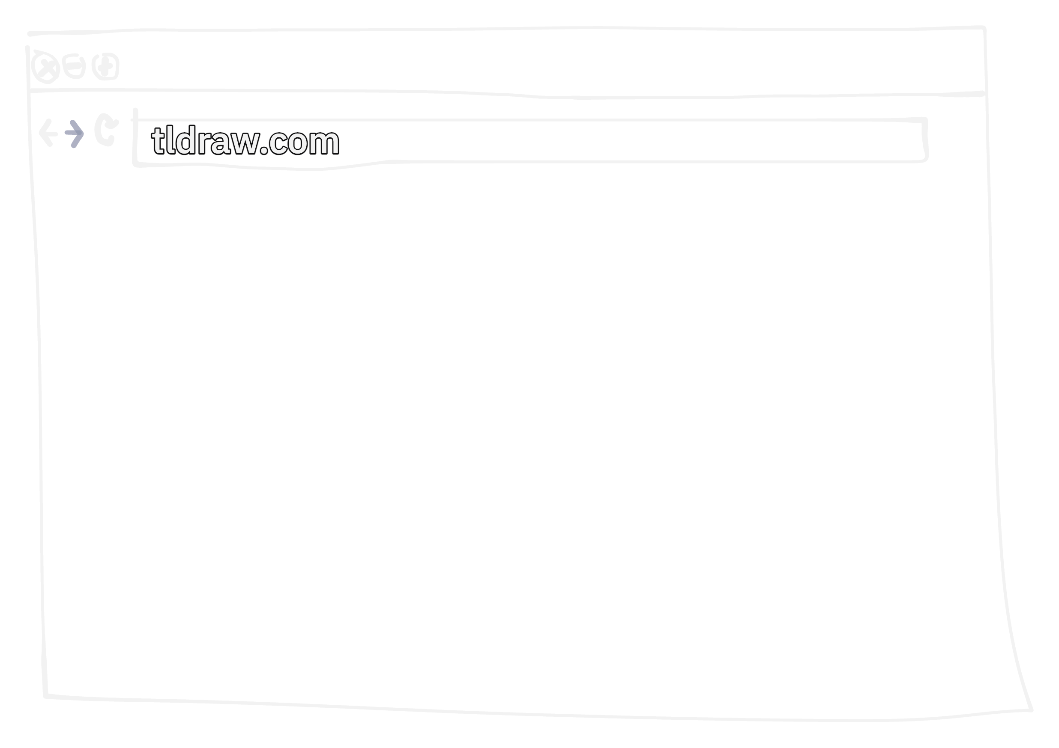
Notes:
If you want to at the end, you can open tldraw.com in your browser and open the .tldr-file I’ve posted on dot.festival-Slack /random-channel.

Slide 52

Notes:
If you want to at the end, you can open tldraw.com in your browser and open the .tldr-file I’ve posted on dot.festival-Slack /random-channel.

Slide 53
Notes:
Thank you for your time!

